Slide 1




Software and
energy aware computing
Kerstin Eder
Design Automation and Verification, Microelectronics
Verification and Validation for Safety in Robots, Bristol Robotics Laboratory
Department of
COMPUTER SCIENCE

Slide 2

Bristol

Slide 3
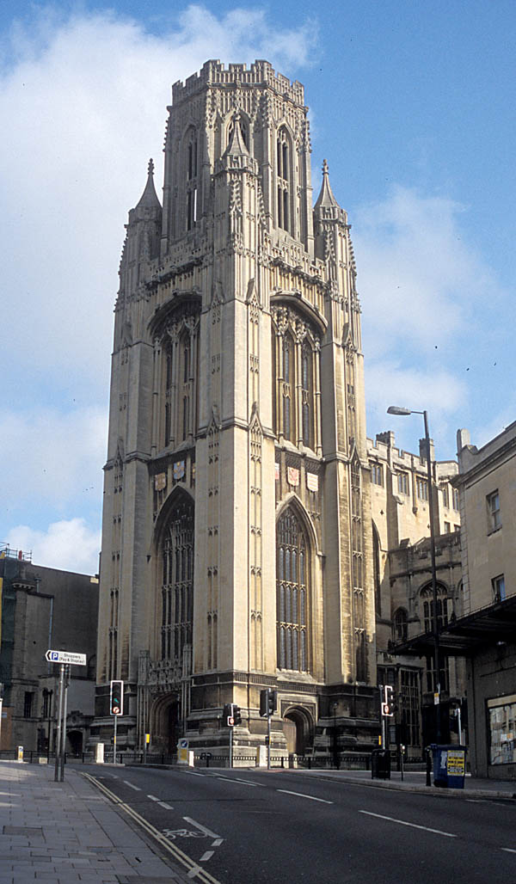
The University of Bristol
1876, University College
UoB founded in 1909
The first higher education institution in England to admit women on an equal basis to men. ☺
Top 30 universities globally
(QS World University Rankings)
6 Faculties
~14.000 students, 2.000 in FEN
Computer Science in FEN
EACO Workshops

Slide 4
Software and
energy aware computing
More power to software developers!
Kerstin Eder
Design Automation and Verification, Microelectronics
Verification and Validation for Safety in Robots, Bristol Robotics Laboratory
Department of
COMPUTER SCIENCE

Slide 5
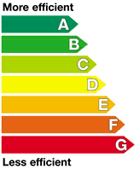
Overview
Introduction and Motivation
Energy consumption of Computing
Software vs Hardware

Slide 6
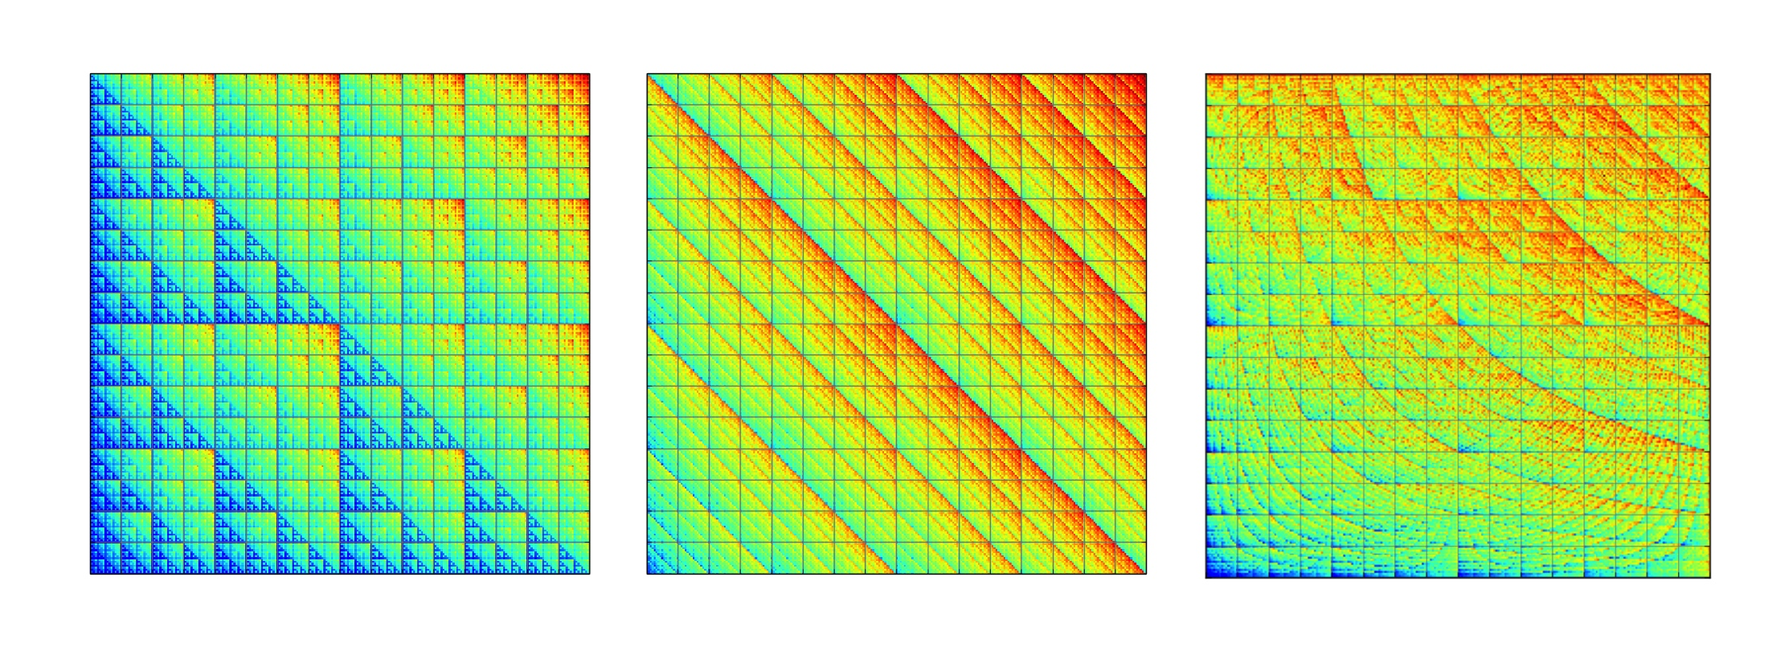
Overview
Introduction and Motivation
Energy consumption of Computing
Software vs Hardware
Energy Transparency
Measuring the energy consumption of software
Demonstration with hands-on session by Steve Kerrison
Energy modeling
Fundamentals of static analysis of software
Static analysis and optimization

Slide 7
Learning Objectives
Why software is key to energy efficient computing
What energy transparency means and why we need energy transparency to achieve energy efficient computing
How to measure the energy consumed by software
How to estimate the energy consumed by software without measuring
How to construct energy consumption models
What holds us back and what is left to do

Slide 8


Introduction and Motivation
Pictures taken from the Energy Efficient Computing Brochure at: https://connect.innovateuk.org/documents/3158891/9517074/Energy%20Efficient%20Computing%20Magazine?version=1.0
Notes:
This calls for Energy Aware System Design

Slide 9


Pictures taken from the Energy Efficient Computing Brochure at: https://connect.innovateuk.org/documents/3158891/9517074/Energy%20Efficient%20Computing%20Magazine?version=1.0
Notes:
Whether embedded systems, mobile devices, or the large-scale systems that help predict the weather

Slide 10

Pictures taken from the Energy Efficient Computing Brochure at: https://connect.innovateuk.org/documents/3158891/9517074/Energy%20Efficient%20Computing%20Magazine?version=1.0
Notes:
Energy efficiency is the limiting factor in system design.
Energy has become the primary limiting factor in the development of all systems, whether due to the cost of energy or cooling in large systems or due to battery life in mobile devices.

Slide 11
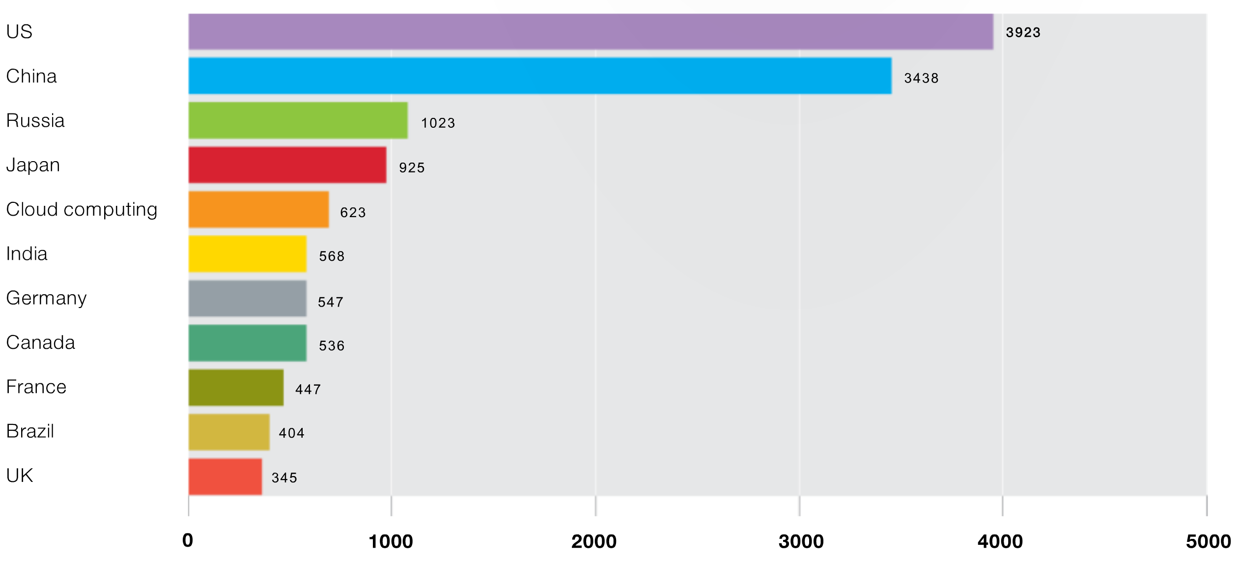
Electricity Consumption (Billion kwH, 2007)
Cloud computing
UK
UK
Greenpeace’s Make IT Green Report, 2010.
http://www.greenpeace.org/international/en/publications/Campaign-reports/Climate-Reports/How-Clean-is-Your-Cloud/
Notes:
More than 10% of the world’s energy consumption is spent on computing.
IT creates 50% more CO2 than the aviation sector. (2014)
Cloudland is the 5th largest consumer of electricity – consuming almost twice as much as the UK!
http://www.vertatique.com/ict-10-global-energy-consumption
http://www.vertatique.com/what-attached-our-global-ict-infrastructure

Slide 12

“Despite improved energy efficiency, energy consumption through electronic devices will triple until 2030 because of a massive rise in overall demand.”
12
Notes:
Predictions suggest that energy consumption through electronic devices will TRIPLE until 2030

Slide 13

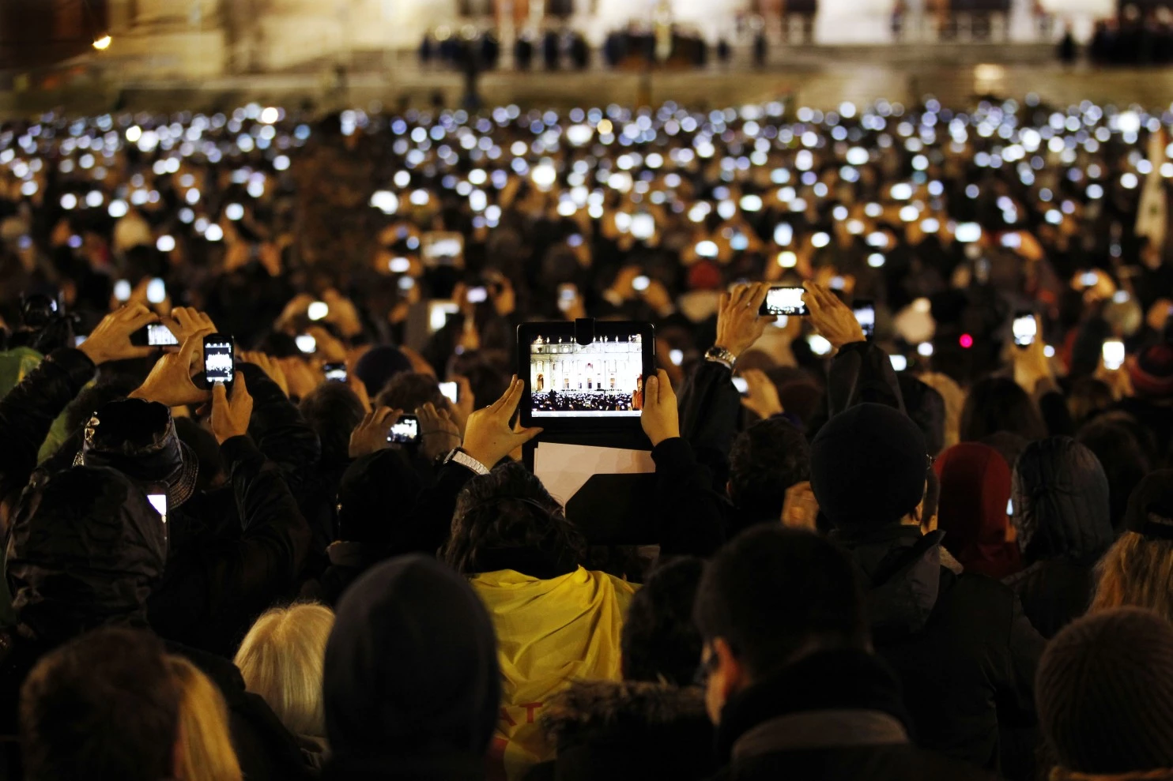
Crowds in St. Peter’s Square
2005
2013
http://www.spiegel.de/panorama/bild-889031-473266.html
Notes:
In less than 10 years the same scene looks very different.
Since 2014 the number of electronic devices has more than doubled – being estimated at 19 Billion at the moment.
There are officially more mobile devices than people in the world 2014 – 7.2 Billion.
Estimates now 19 Billion.

Slide 14

Energy Aware Computing
Notes:
This calls for Energy Aware System Design

Slide 15
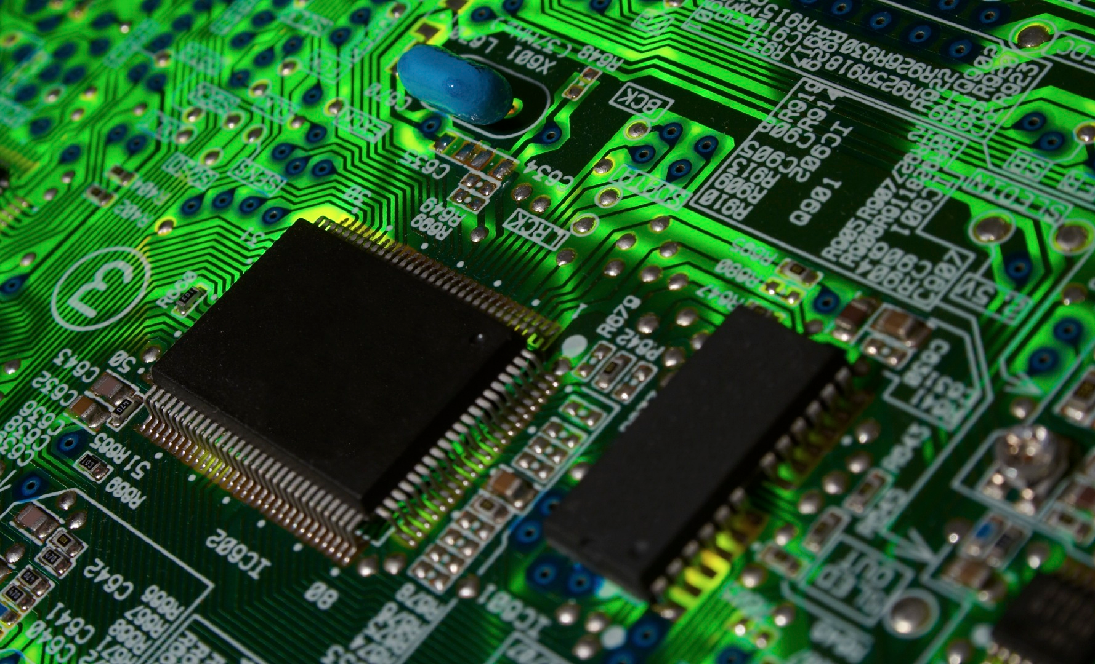
Energy Efficiency of ICT
arChitecture
Blocks
gAtes
http://www.clker.com/cliparts/f/0/5/1/12937499341853355695circuit-board.jpg
Notes:
Low power has been the focus for hardware developers for more than a decade with great success.

Slide 16
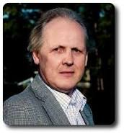
A historical perspective
(based on an inspiring talk by Steve Furber)

Slide 17
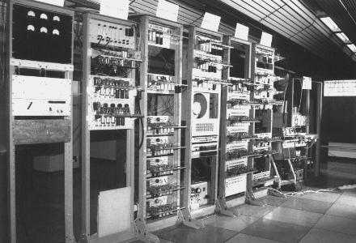
The Baby (1948)
filled a medium-sized room
executed
700 instructions per second
Notes:
So, how did we get all this technology?
The story really gets underway 50 years ago. The first modern computer – the first computer to run a program stored in its memory – was the Manchester baby machine, built in this university, which ran the world’s first computer program in June 1948.
The Manchester Small-Scale Experimental Machine (SSEM), nicknamed Baby, was the world's first stored-program computer. It was built at the Victoria University of Manchester, England, by Frederic C. Williams, Tom Kilburn and Geoff Tootill, and ran its first program on 21 June 1948.
3 bit instruction encoding with 32-bit word length and a memory of 32 words
---
This is a photo of a replica of the Baby, built for the 50th anniversary of the first program, and now a permanent exhibit in the Museum of Science and Industry.

Slide 18
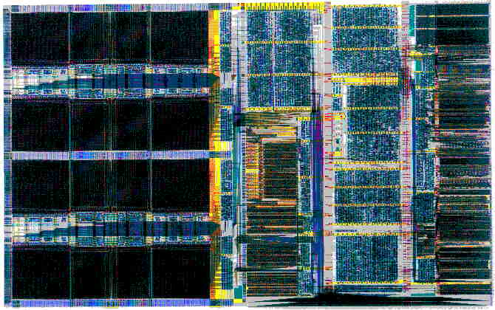
The ARM968 (2005)
fills 0.4mm² of silicon
executes 200,000,000 instructions per second
~300,000 times more than the Baby!
2.5mm
4mm
Notes:
The ARM968E-S is a fully synthesizable 32-bit RISC processor aimed specifically at embedded real-time applications, and is the smallest, lowest power ARM9 family processor.
About 50 years later technology had moved on. This is a photo of a telecommunications controller, the processing part of which was developed by Steve Furber in Manchester.
It’s pretty typical of the sort of chip that is going into a whole lot of today’s low-power, mobile computing systems.
A comparison of Baby with ARM968 illustrates some interesting points…

Slide 19
~60 years of progress
Baby, 1948:
filled a medium-sized room
used 3.5 kW of electrical power
executed 700 instructions per second
ARM968, 2005:
fills 0.4mm² of silicon (130nm)
uses 20 mW of electrical power
executes 200,000,000 instructions per second
Notes:
In just 50 years computers have gone:
- from filling a room to fitting on a fingernail;
- from using a large mains supply to running for hours of small batteries;
- from executing a few hundred instructions a second to executing tens or hundreds of millions a second

Slide 20
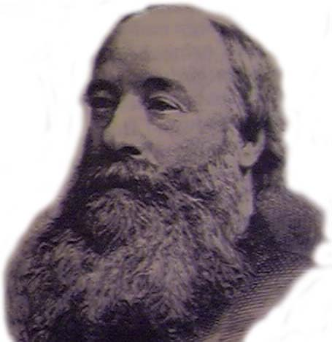
Energy efficiency
Baby:
5 Joules per instruction
ARM968:
100 pico Joules per instruction
(James Prescott Joule born Salford, 1818)
Notes:
We can some idea of the relative efficiencies of these two machines by comparing their “fuel efficiency”. In the case of a computer, this is the energy taken to execute one instructions.
Baby consumed about 5 Joules per instruction;
DRACO consumes a whole lot less, namely 100pJ
The ratio of these two numbers is over 2 billion (in fact, 50 billion), which is one of these numbers that comes up in computing technology that is very hard to get a feel for.
If cars had improved by a similar ratio in their fuel efficiency, a few gallons of petrol would be enough to keep the UK mobile for a year, and the oil crisis would be forgotten.
However, there are, of course, good reasons why cars cannot achieve such levels of fuel efficiency. Whereas there is no lower limit to the fuel efficiency of computing – it can, at least in theory, be done with no energy at all…

Slide 21
Energy efficiency
Baby:
5 Joules per instruction
ARM968:
0.000 000 000 1 Joules per instruction
50,000,000,000 times better than Baby!
(James Prescott Joule born Salford, 1818)
Notes:
We can some idea of the relative efficiencies of these two machines by comparing their “fuel efficiency”. In the case of a computer, this is the energy taken to execute one instructions.
Baby consumed about 5 Joules per instruction;
DRACO consumes a whole lot less, namely 100pJ
The ratio of these two numbers is over 2 billion (in fact, 50 billion), which is one of these numbers that comes up in computing technology that is very hard to get a feel for.
If cars had improved by a similar ratio in their fuel efficiency, a few gallons of petrol would be enough to keep the UK mobile for a year, and the oil crisis would be forgotten.
However, there are, of course, good reasons why cars cannot achieve such levels of fuel efficiency. Whereas there is no lower limit to the fuel efficiency of computing – it can, at least in theory, be done with no energy at all…

Slide 22

10 more years of progress
Baby, 1948:
filled a medium-sized room
used 3.5 kW of electrical power
executed 700 instructions per second
ARM968, 2005
fills 0.4mm² of silicon (130nm)
uses 20 mW of electrical power
executes 200,000,000 instructions per second
ARM Cortex-A35, 2015
smallest area configuration <0.25mm²
uses less than 4 mW of electrical power at 100 MHz
executes ~210,000,000 instructions per second
Notes:
The ARM® Cortex-A35 processor is ARM’s most power-efficient application processor capable of seamlessly supporting 32-bit and 64-bit compute.
A35 also has a rather larger instruction set to implement, too...
For ARM Cortex-A35, ARM marketing states:
Smallest area configuration 0.25 mm²
Less than 4 mW at 100 MHz
Then, from https://en.wikipedia.org/wiki/Comparison_of_ARMv8-A_cores you can see DMIPS/MHz for A35 = 2.1

Slide 23
Hardware Design
Power management largely in domain of Hardware Design
Considerations to minimize/optimize
Dynamic (switching) and static (leakage) power
On-chip power management
Modes: on, standby, suspend, sleep, off
Development of low power electronics
Where can the greatest savings be made?

Slide 24
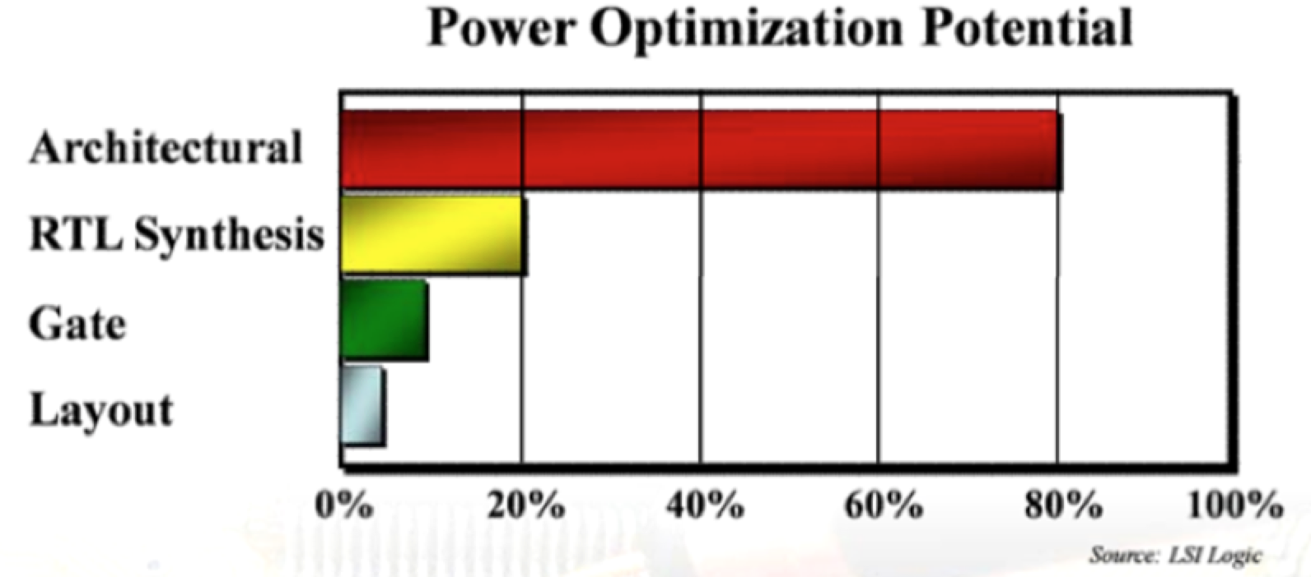
Greater Savings at Higher Levels

Slide 25

ElectronicsWeekly 15-21 June 2011 | No. 2472

Slide 26

Wasted Potential
Huge advances have been made in power-efficient hardware.
BUT – potential energy savings are wasted by
software that does not exploit energy-saving features of hardware;
poor dynamic management of tasks and resources.

Slide 27

Energy Efficiency of ICT
alGorithms
soFtware
compilErs
Drivers
http://static.datixinc.com/wp-content/uploads/2015/04/7.jpg
arChitecture
Blocks
gAtes
http://www.clker.com/cliparts/f/0/5/1/12937499341853355695circuit-board.jpg
Notes:
Software does not do a good job.
Potential energy savings enabled by low power hardware are wasted by software that does not exploit these.

Slide 28


The Focus is on Software
Software controls the behaviour of the hardware
Algorithms and Data Flow
Compiler (optimizations)
Traditional SW design goals:
performance,
performance,
performance

Slide 29
The Focus is on Software
Software engineers often “blissfully unaware”
Implications of algorithm/code/data on power/energy?
Power/Energy considerations
at best, secondary design goals
BUT the biggest savings can be gained from optimizations at the higher levels of abstraction in the system stack
Algorithms,
Data and
SW

Slide 30
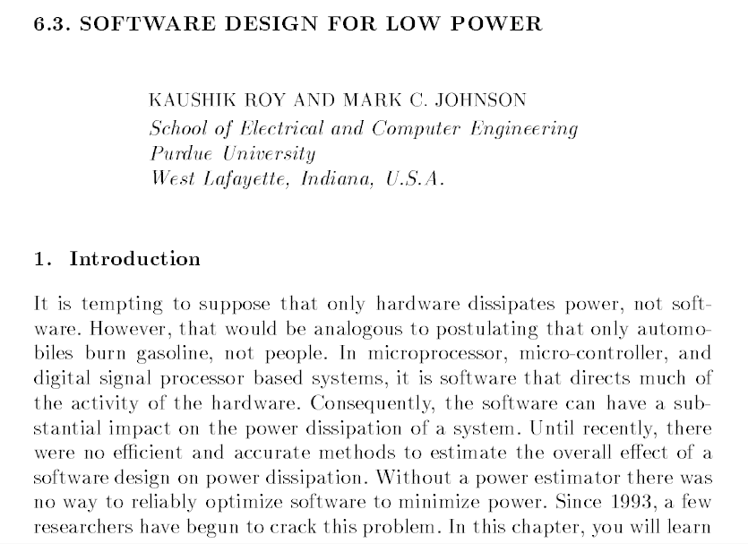
Notes:
We need to acknowledge that ultimately, it is the software that controls what the hardware does.

Slide 31
Aligning SW Design Decisions with Energy Efficiency as Design Goal
Key steps*:
“Choose the best algorithm for the problem at hand and make sure it fits well with the computational hardware. Failure to do this can lead to costs far exceeding the benefit of more localized power optimizations.
Minimize memory size and expensive memory accesses through algorithm transformations, efficient mapping of data into memory, and optimal use of memory bandwidth, registers and cache.
Optimize the performance of the application, making maximum use of available parallelism.
Take advantage of hardware support for power management.
Finally, select instructions, sequence them, and order operations in a way that minimizes switching in the CPU and datapath.”
Kaushik Roy and Mark C. Johnson. 1997. “Software design for low power”. In Low power design in deep submicron electronics, Wolfgang Nebel and Jean Mermet (Eds.). Kluwer Nato Advanced Science Institutes Series, Vol. 337. Kluwer Academic Publishers, Norwell, MA, USA, pp 433-460.
Notes:
Which SW developer tries to match algorithms to hardware?
For decades – moved SW away from HW – productivity, portability, …

Slide 32

How much?
Notes:
The problem is:
What we can’t see, we can’t optimize.

Slide 33

Energy Transparency
Notes:
Information on energy usage is available for programs:
ideally without executing them, and
at all levels of abstraction.

Slide 34
Energy Transparency
Information on energy usage is available for programs:
ideally without executing them, and
at all levels from machine code to high-level application code.
34

Slide 35
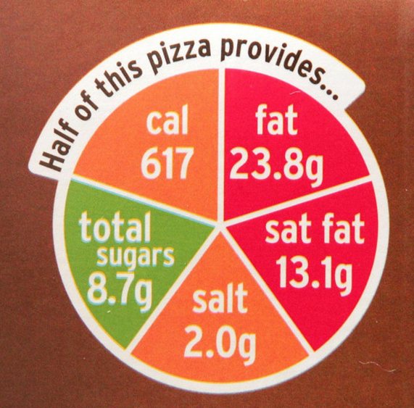
Transparency

Slide 36
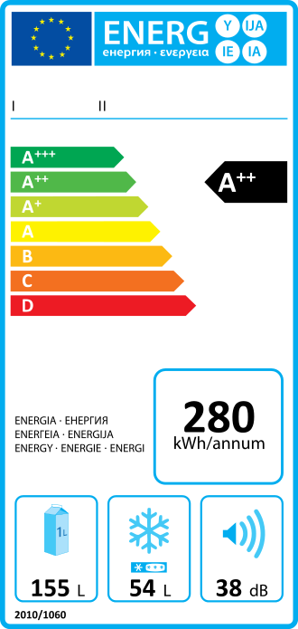
Transparency

Slide 37

Transparency
Notes:
We need energy consumption functions, rather than single values. ☺

Slide 38

Why Energy Transparency?
Energy transparency enables a deeper understanding of how algorithms and coding impact on the energy consumption of a computation when executed on hardware.
38
Notes:
In a nutshell, we can’t improve what we can’t measure! ☺

Slide 39
Learning Objectives
Why software is key to energy efficient computing
What energy transparency means and why we need energy transparency to achieve energy efficient computing
How to measure the energy consumed by software
How to estimate the energy consumed by software without measuring
How to construct energy consumption models
What holds us back and what is left to do

Slide 40
Learning Objectives
Why software is key to energy efficient computing
What energy transparency means and why we need energy transparency to achieve energy efficient computing
How to measure the energy consumed by software
How to estimate the energy consumed by software without measuring
How to construct energy consumption models
What holds us back and what is left to do

Slide 41
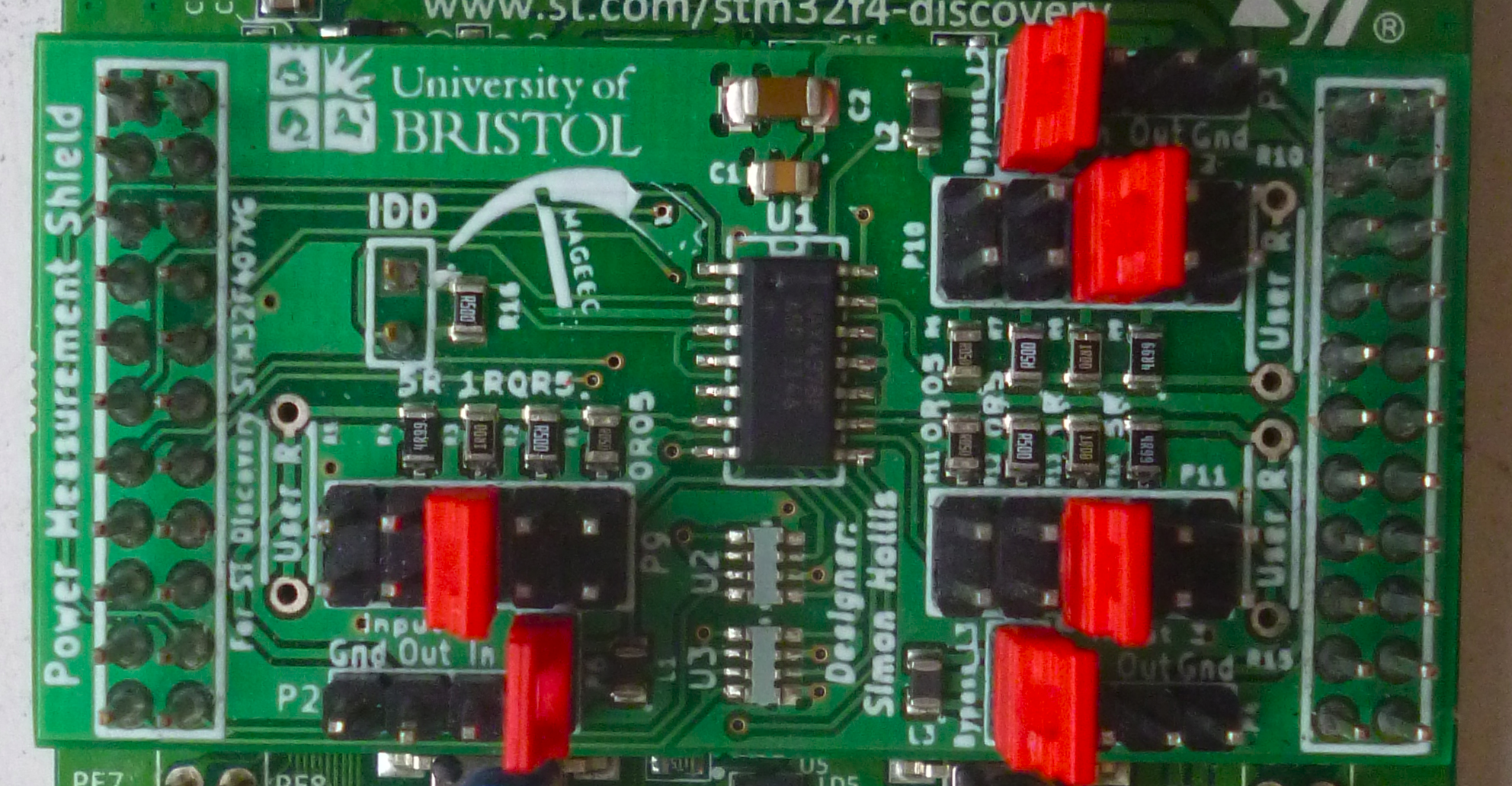
Measuring the Energy Consumption of Computation
Notes:
The first step towards energy transparency is being able to *measure*.

Slide 42
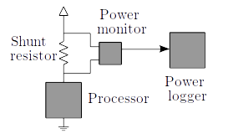
Measuring Power
Measure voltage drop
across the resistor
I = V_{shunt} / R_{shunt} to find the current.
Measure voltage at
one side of the resistor
P = I × V to calculate the power.
Notes:
Circuitry behind measuring power, how it works

Slide 43
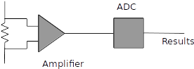
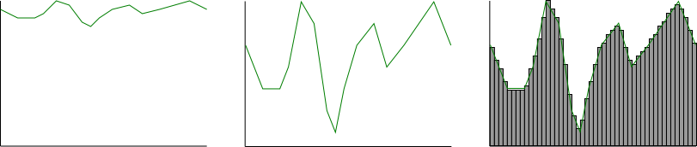
The Power Monitor
Amplifier
ADC

Slide 44
Measuring Power
Measure voltage drop
across the resistor
I = V_{shunt} / R_{shunt} to find the current
Repeat frequently, timestamp
each sample
Measure voltage at
one side of the resistor
P = I × V to calculate the power
Notes:
Circuitry behind measuring power, how it works

Slide 45
Measuring Energy
Energy
Power
Time
Notes:
Power trace
Integrate this - energy

Slide 46
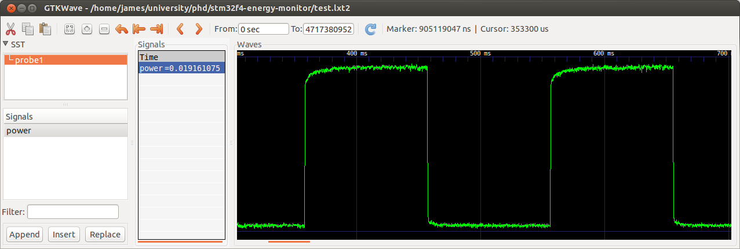
How much data?
Currently 500,000 Samples/second
6,000,000 S/s possible in bursts
Notes:
Stream back over usb, not fast enough
Burst up to 6000000
Visualise power traces in gtkwave

Slide 47

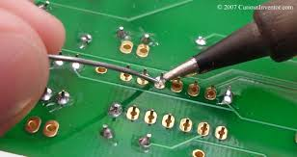
The Showstopper ☹
Notes:
But, soldering is still not part of our CS programmes, nor of any SW Engineering courses. ☹

Slide 48
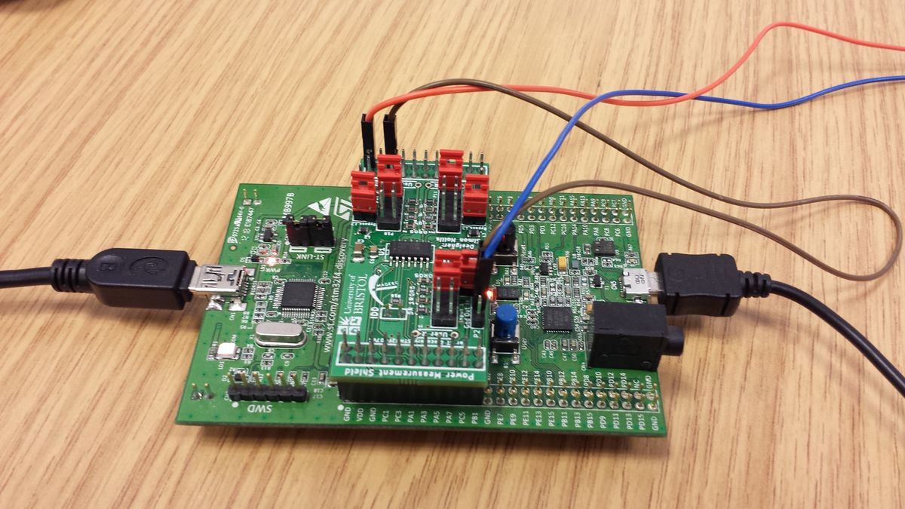
Open Energy Measurement Board
http://mageec.org/
Notes:
To bridge this gap…open source, design can be downloaded from mageec.org!

Slide 49
Open Energy Measurement Board
http://mageec.org/
Notes:
To bridge this gap…open source, design can be downloaded from mageec.org!

Slide 50

Open Energy Measurement Board
http://groundelectronics.com/products/mageec-energy-measurement-kit

Slide 51
Energy Measurement A hands-on session by Steve Kerrison

Slide 52
Summary: Energy Measurement
We can directly measure the energy consumed during the execution of a program.
In most cases, specialized hardware and modifications to hardware are required to enable measurement.
The accuracy of the measurements depends on the sampling frequency and on the measuring hardware.

Slide 53
Dynamic Energy Monitoring for desktop applications

Slide 54
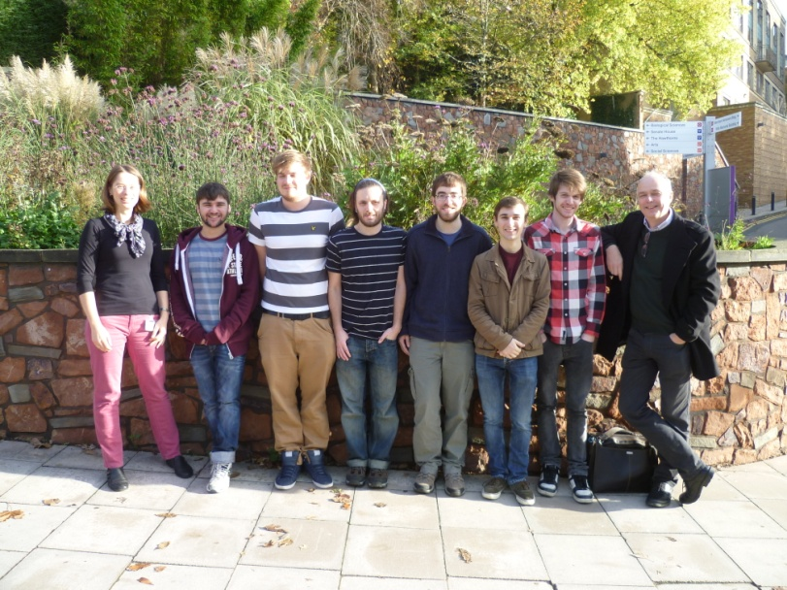
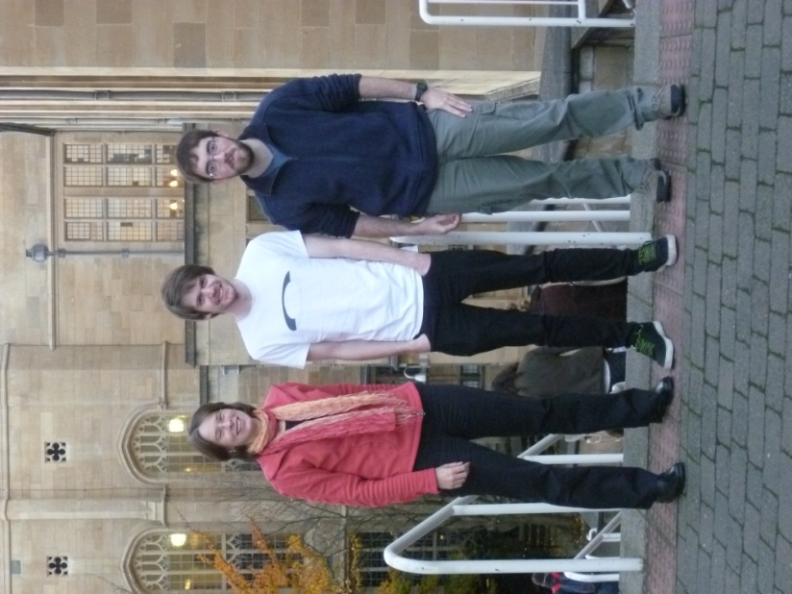
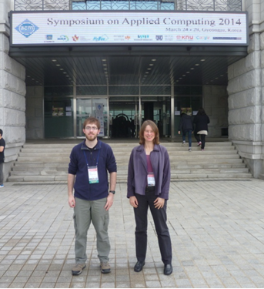
The EACOF
A simple Energy-Aware
COmputing Framework
https://github.com/eacof

Slide 55
High Level
Provider Central Authority Consumer
Energy Data From Hardware or OS
EACOF
Application

Slide 56
Providers
Provider Central Authority Consumer
EACOF
Application
CPU Provider
Battery Provider
HDD Provider

Slide 57
Consumers
Provider Central Authority Consumer
EACOF
CPU Provider
Email Client
Battery Provider
Video Player
HDD Provider
Web Browser

Slide 58
One Machine
Provider Central Authority Consumer
EACOF
CPU Provider
Email Client
Battery Provider
Video Player
HDD Provider
Web Browser

Slide 59
Networked
CPU Provider
EACOF
Email Client
CPU Provider
EACOF
Email Client
Battery Provider
Video Player
Battery Provider
Video Player
HDD Provider
Web Browser
HDD Provider
Web Browser
Network Analytics
CPU Provider
EACOF
Email Client
CPU Provider
EACOF
Email Client
Battery Provider
Video Player
Battery Provider
Video Player
HDD Provider
Web Browser
HDD Provider
Web Browser

Slide 60
How to use EACOF

Slide 61
Simple Provider Example
while(1) {
collectEnergyData();
waitABit();
}

Slide 62
Simple Provider Example + EACOF
#include <eacof.h>
eacof_Probe *probe;
eacof_Sample sample;
initEACOF();
createProbe(&probe, 1, EACOF_DEVICE_BATTERY_ALL);
while(1) {
sample = collectEnergyData();
addSample(probe, sample);
waitABit();
}
deleteProbe(&probe);

Slide 63
Simple Consumer Example
for (int i = 0; i < 10000; i++) {
printf(“Hello EACOF!”);
}

Slide 64
Simple Consumer Example + EACOF
#include <eacof.h>
eacof_Checkpoint *checkpoint;
eacof_Sample sample;
initEACOF();
setCheckpoint(&checkpoint, EACOF_PSPEC_ALL, 1, EACOF_DEVICE_BATTERY_ALL);
for (int i = 0; i < 10000; i++) {
printf(“Hello EACOF!\n”);
sampleCheckpoint(checkpoint, &sample);
}
deleteCheckpoint(&checkpoint);

Slide 65
The EACOF API
#include <eacof.h>
initEACOF();
createProbe(); deleteProbe();
activateProbe(); deactivateProbe();
addSample();
setCheckpoint(); deleteCheckpoint();
sampleCheckpoint();

Slide 66
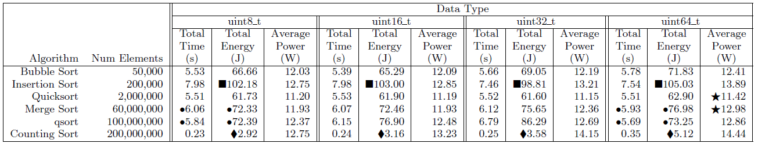
Comparing Sorting Algorithms
Sorting of integers in [0,255]
Insertion Sort: 32 bit version more optimized
Counting Sort:
75% more energy for 64 bit compared to 8 bit values
Sorting 64 bit values takes less time than sorting 8 bit values, but consumed more energy
Average power variations between algorithms
H. Field, G. Anderson and K. Eder. “EACOF: A Framework for Providing Energy Transparency to enable Energy-Aware Software Development”. 29th ACM Symposium On Applied Computing. pp. 1194–1199. March 2014, ACM.
66

Slide 67
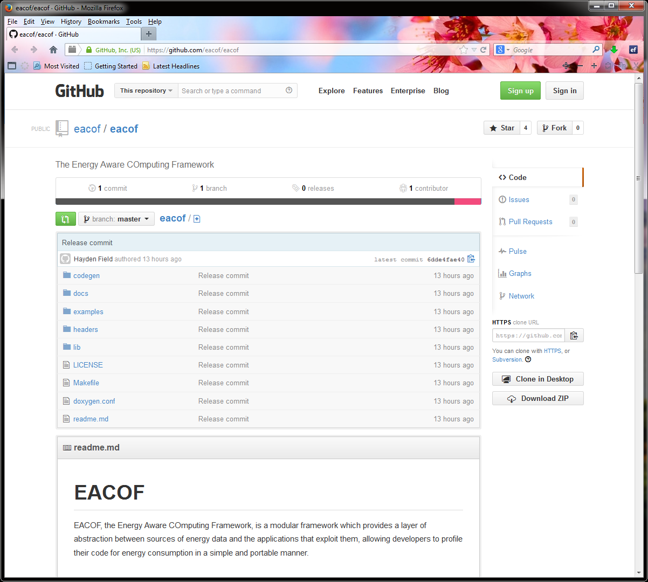
Invitation: EACOF is open source!
github.com/eacof

Slide 68
Learning Objectives
Why software is key to energy efficient computing
What energy transparency means and why we need energy transparency to achieve energy efficient computing
How to measure the energy consumed by software
How to estimate the energy consumed by software without measuring
How to construct energy consumption models
What holds us back and what is left to do

Slide 69
Learning Objectives
Why software is key to energy efficient computing
What energy transparency means and why we need energy transparency to achieve energy efficient computing
How to measure the energy consumed by software
How to estimate the energy consumed by software without measuring
How to construct energy consumption models
What holds us back and what is left to do

Slide 70
Static Analysis for Energy Consumption

Slide 71

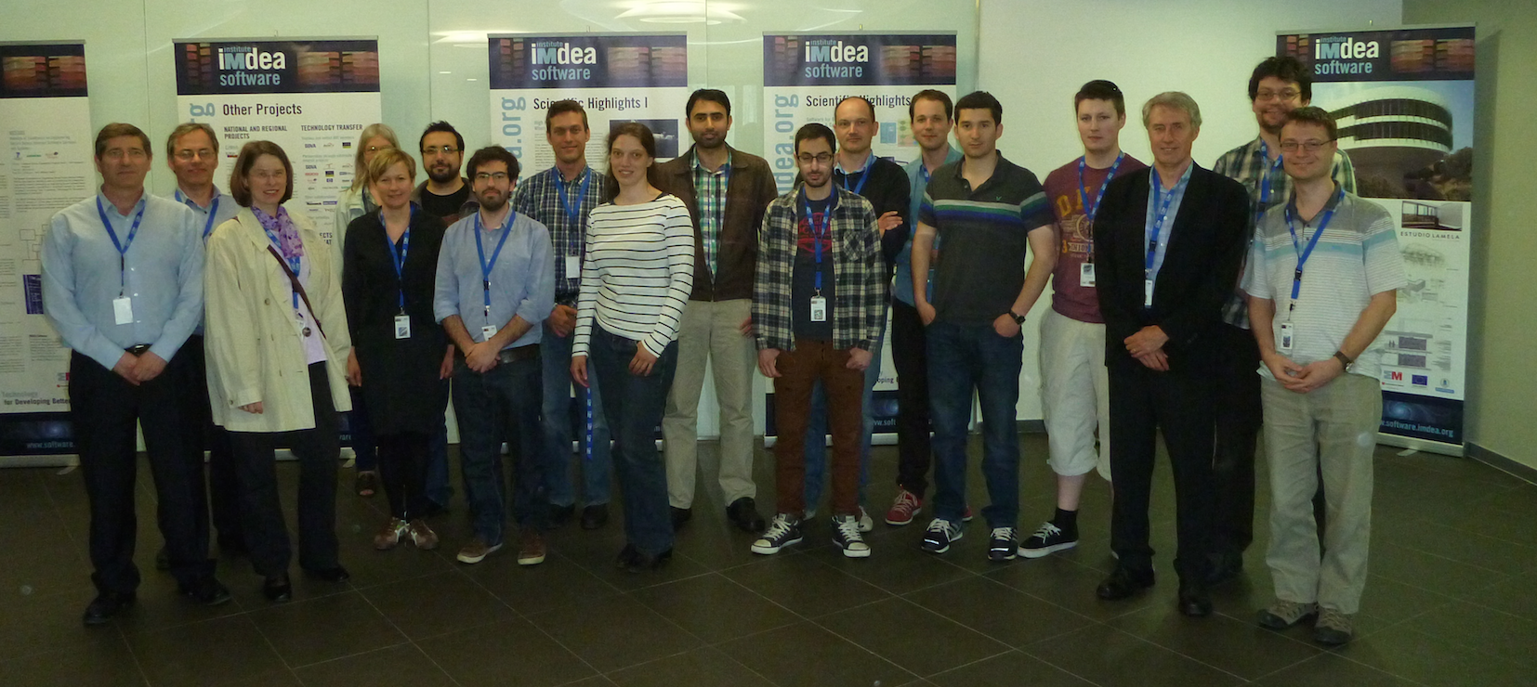

Slide 72






The ENTRA Project
Whole Systems ENergy TRAnsparency
EC FP7 FET MINECC:
“Software models and programming methodologies supporting the strive for the energetic limit
(e.g. energy cost awareness or exploiting the trade-off between energy and performance/precision).”
72

Slide 73
SRA for Energy Consumption
Adaptation of traditional resource usage analysis techniques to energy consumption.
Techniques automatically infer upper and lower bounds on energy usage of a program.
Bounds expressed using monotonic arithmetic functions per procedure parameterized by program’s input size.
Verification can be done statically by checking that the upper and lower bounds on energy usage and any other resource defined in the specifications hold.
73
Notes:
Static cost analysis techniques based on setting up and solving recurrence equations date back to Wegbreit’s seminal work in 1975,
and have been developed significantly in subsequent work.

Slide 74
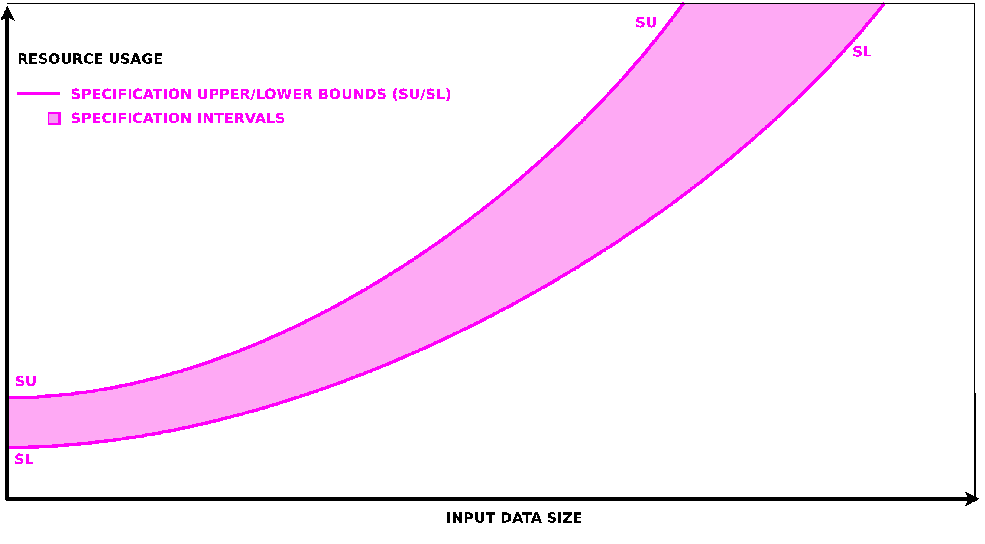
Specified Resource Usage
Source: Pedro Lopez Garcia, IMDEA Software Research Institute
74

Slide 75
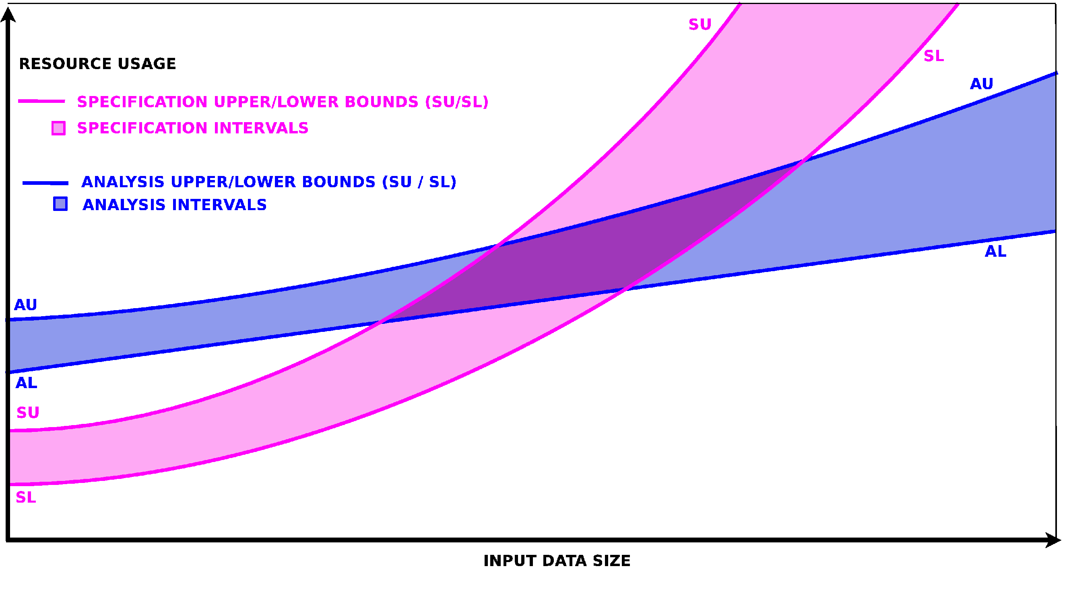
Analysis Result
Source: Pedro Lopez Garcia, IMDEA Software Research Institute
75

Slide 76
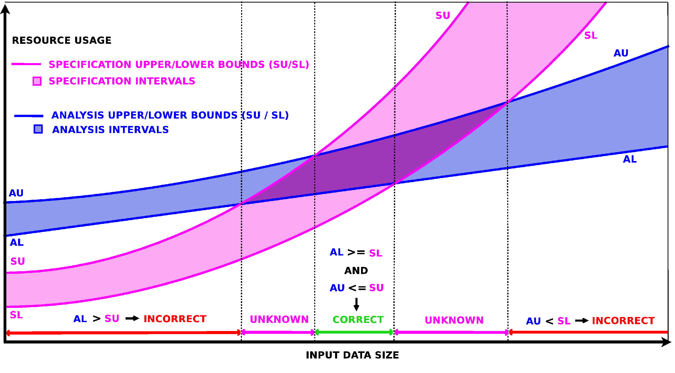
Verification
Source: Pedro Lopez Garcia, IMDEA Software Research Institute
76

Slide 77
Static Energy Usage Analysis
Original Program:
Extracted Cost Relations:
int fact (int x) {
if (x<=0)ª
return 1^{b};
return (x *^{d} fact(x-1))^{c};
}
C_{fact}(x) = C_{a} + C_{b} if x<=0
C_{fact}(x) = C_{a} + C_{c}(x) if x>0
C_{c}(x) = C_{d} + C_{fact}(x-1)
Substitute C_{a}, C_{b}, C_{d} with
the actual energy required to execute the corresponding lower-level (machine) instructions.

Slide 78
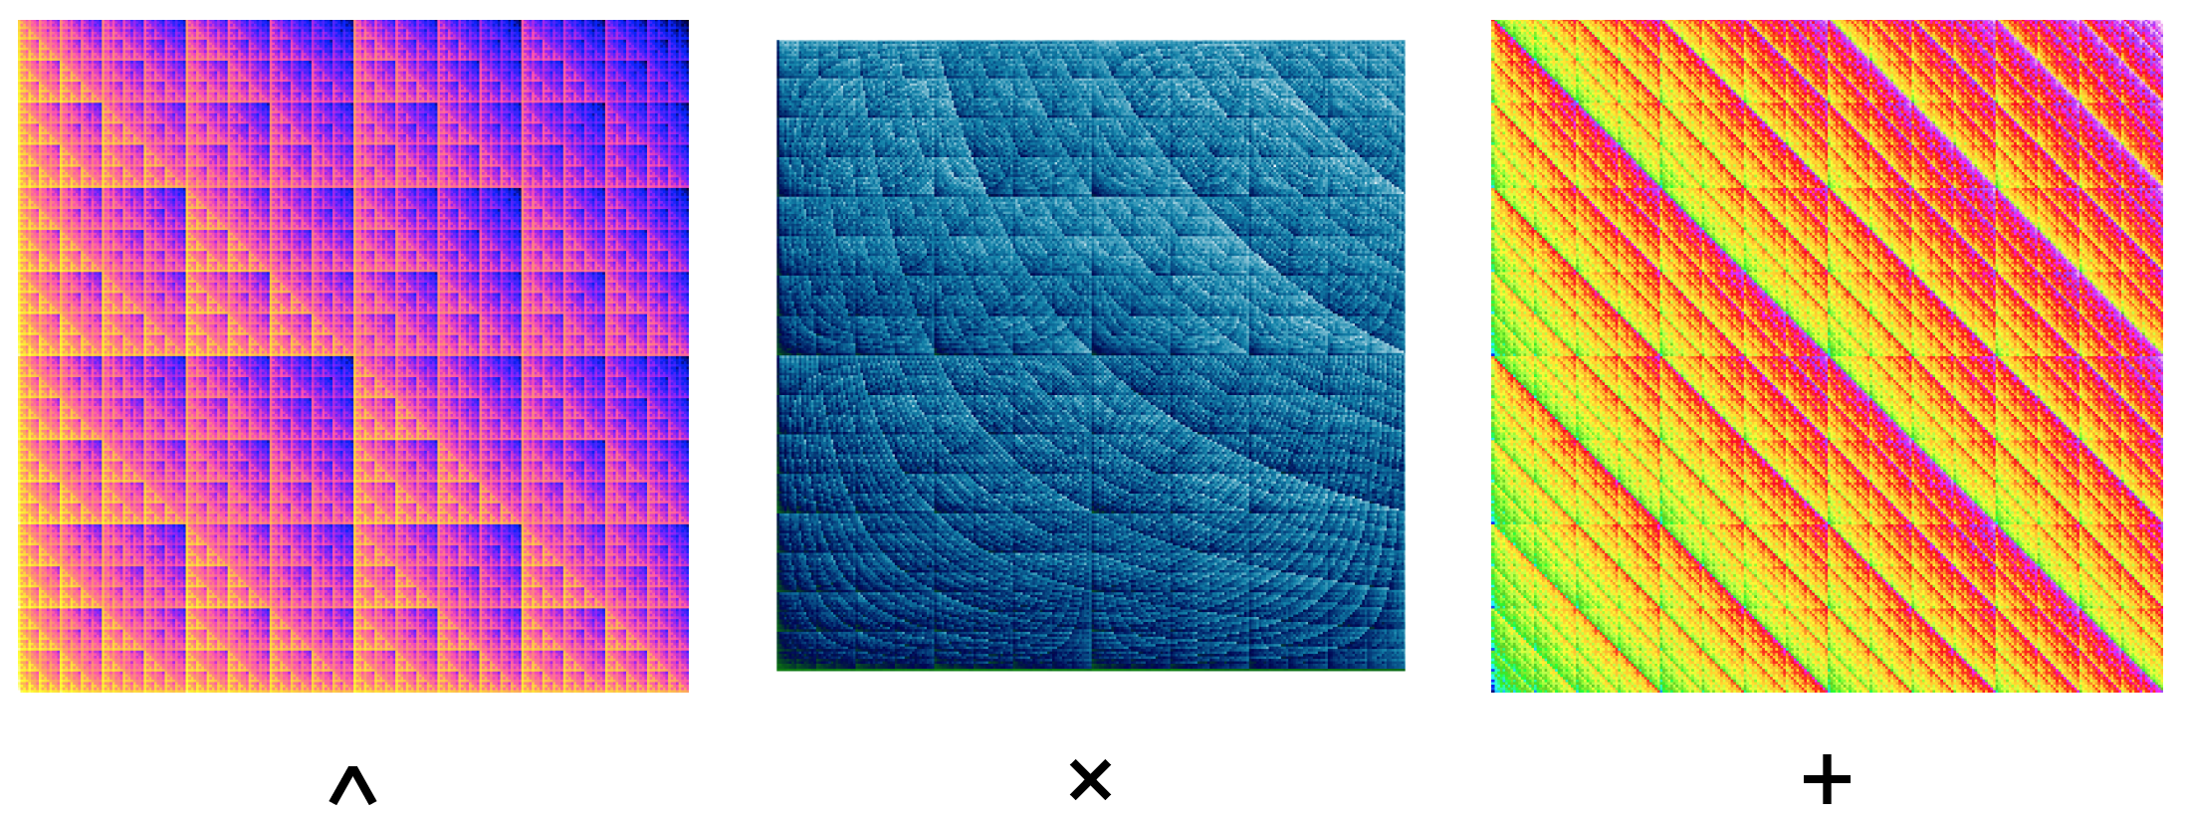
Energy Modelling captures energy consumption

Slide 79
Modelling Considerations
At what level should we model?
instruction level, i.e. machine code
intermediate representation of compiler
source code
Models require measurements
need to associate entities at a given level with costs, i.e. energy consumption
accuracy
usefulness of model

Slide 80
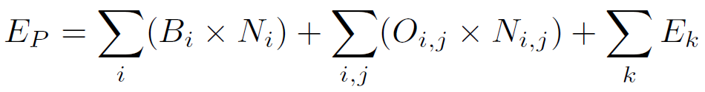
ISA-Level Energy Modelling
Energy Cost (E) of a program (P):
Instruction Base Cost, B_{i}, of each instruction i
Circuit State Overhead, O_{i,j}, for each instruction pair
V. Tiwari, S. Malik and A. Wolfe. “Instruction Level Power Analysis and Optimization of Software”, Journal of VLSI Signal Processing Systems, 13, pp 223-238, 1996.
80

Slide 81
ISA-Level Energy Modelling
Components of an Energy Model:
B_{i} and O_{i,j} are energy costs
Characterization of a model through measurement produces these values for a given processor
V. Tiwari, S. Malik and A. Wolfe. “Instruction Level Power Analysis and Optimization of Software”, Journal of VLSI Signal Processing Systems, 13, pp 223-238, 1996.
81
Notes:
Short excurse into how this may be possible to do:
large loops of each instruction to determine the base costs
large loops of pairs of instructions to determine the switching costs
regression for instructions that can’t easily be tested
Which data should we use?

Slide 82
ISA-Level Energy Modelling
Components of an Energy Model:
N_{i} and N_{i,j} represent the number of occurrences of instructions and instruction pairs in a given program
V. Tiwari, S. Malik and A. Wolfe. “Instruction Level Power Analysis and Optimization of Software”, Journal of VLSI Signal Processing Systems, 13, pp 223-238, 1996.
82
Notes:
Short excurse into how this may be possible to do:
large loops of each instruction to determine the base costs
large loops of pairs of instructions to determine the switching costs
regression for instructions that can’t easily be tested
Which data should we use?

Slide 83
Exercise: E(fact(3))?
int fact (int x) {
int ret = x;
while (--x)
{
ret *= x;
}
return ret;
}
How much energy does a call to fact(3) consume?
fact:
sub r3, r0, #1
cmp r3, #0
beq .L2
.L3:
mul r0, r3
sub r3, r3, #1
cmp r3, #0
bne .L3
.L2:
bx lr
Notes:
translate into machine instructions
characterize the energy consumption of instructions – ISA level model

Slide 84
Base Cost Characterization
Instruction | Base Cost [pJ]
sub | 600
cmp | 300
beq | 500
mul | 900
bne | 500
bx | 700
fact:
sub r3, r0, #1
cmp r3, #0
beq .L2
.L3:
mul r0, r3
sub r3, r3, #1
cmp r3, #0
bne .L3
.L2:
bx lr
Notes:
If we take the values for B and O to be in pJ, and imagine the processor runs at 100 MHz, then the base power of beq would be 500 pJ / 10 ns, which is 50 mW, which is a sensible value (anything from 1 mW to 100 mW is probably OK, depending on the processor imagined). The overheads are small to about the proportion we see on an XCore (10%) so again are sensible.

Slide 85
Overhead Characterization
fact:
sub r3, r0, #1
cmp r3, #0
beq .L2
.L3:
mul r0, r3
sub r3, r3, #1
cmp r3, #0
bne .L3
.L2:
bx lr
O_{i,j} [pJ] | beq | bne | bx | cmp | mul | sub
beq | 0 | 10 | 10 | 30 | 30 | 30
bne | 10 | 0 | 10 | 30 | 30 | 30
bx | 10 | 10 | 0 | 60 | 60 | 60
cmp | 10 | 10 | 10 | 0 | 20 | 20
mul | 10 | 10 | 10 | 30 | 0 | 30
sub | 10 | 10 | 10 | 20 | 30 | 0
Notes:
If we take the values for B and O to be in pJ, and imagine the processor runs at 100 MHz, then the base power of beq would be 500 pJ / 10 ns, which is 50 mW, which is a sensible value (anything from 1 mW to 100 mW is probably OK, depending on the processor imagined). The overheads are small to about the proportion we see on an XCore (10%) so again are sensible.

Slide 86
Instruction Characterization
Instruction | Base Cost [pJ]
beq | 500
bne | 500
bx | 700
cmp | 300
mul | 900
sub | 600
O_{i,j} [pJ] | beq | bne | bx | cmp | mul | sub
beq | 0 | 10 | 10 | 30 | 30 | 30
bne | 10 | 0 | 10 | 30 | 30 | 30
bx | 10 | 10 | 0 | 60 | 60 | 60
cmp | 10 | 10 | 10 | 0 | 20 | 20
mul | 10 | 10 | 10 | 30 | 0 | 30
sub | 10 | 10 | 10 | 20 | 30 | 0
Notes:
If we take the values for B and O to be in pJ, and imagine the processor runs at 100 MHz, then the base power of beq would be 500 pJ / 10 ns, which is 50 mW, which is a sensible value (anything from 1 mW to 100 mW is probably OK, depending on the processor imagined). The overheads are small to about the proportion we see on an XCore (10%) so again are sensible.

Slide 87
ISA-Level Energy Modelling
Components of an Energy Model:
B_{i} and O_{i,j} are energy costs
Characterization of a model through measurement produces these values for a given processor
V. Tiwari, S. Malik and A. Wolfe. “Instruction Level Power Analysis and Optimization of Software”, Journal of VLSI Signal Processing Systems, 13, pp 223-238, 1996.
87
Notes:
Short excurse into how this may be possible to do:
large loops of each instruction to determine the base costs
large loops of pairs of instructions to determine the switching costs
regression for instructions that can’t easily be tested
Which data should we use?

Slide 88
ISA-Level Energy Modelling
Components of an Energy Model:
N_{i} and N_{i,j} represent the number of occurrences of instructions and instruction pairs in a given program
How can we determine these?
V. Tiwari, S. Malik and A. Wolfe. “Instruction Level Power Analysis and Optimization of Software”, Journal of VLSI Signal Processing Systems, 13, pp 223-238, 1996.
88
Notes:
Focus here on “executing” the program by hand, then go into simulation, then static analysis.

Slide 89
Exercise
@ Argument is in r0
fact:
sub r3, r0, #1
cmp r3, #0
beq .L2 @ Never iterate loop if num == 1
.L3:
mul r0, r3 @ Accumulate factorial value in r0
sub r3, r3, #1 @ r3 is decrementing counter
cmp r3, #0
bne .L3 @ Loop if we haven't reached 0
.L2:
bx lr @ Return, answer is in r0
A call to fact(3) would invoke the following instructions in this order:
sub, cmp, beq (not taken),
mul, sub, cmp, bne (taken),
mul, sub, cmp, bne (not taken),
bx
Notes:
determine trace of instructions to be executed to calculate fact(3), fact(3) = 1*2*3=6
this would be: sub, cmp, beq (not taken), mul, sub, cmp,

Slide 90
Exercise
Instruction | Base Cost [pJ]
beq | 500
bne | 500
bx | 700
cmp | 300
mul | 900
sub | 600
O_{i,j} [pJ] | beq | bne | bx | cmp | mul | sub
beq | 0 | 10 | 10 | 30 | 30 | 30
bne | 10 | 0 | 10 | 30 | 30 | 30
bx | 10 | 10 | 0 | 60 | 60 | 60
cmp | 10 | 10 | 10 | 0 | 20 | 20
mul | 10 | 10 | 10 | 30 | 0 | 30
sub | 10 | 10 | 10 | 20 | 30 | 0
A call to fact(3) would invoke the following instructions in this order:
sub, cmp, beq (not taken),
mul, sub, cmp, bne (taken),
mul, sub, cmp, bne (not taken),
bx
Notes:
determine trace of instructions to be executed to calculate fact(3), fact(3) = 1*2*3=6
this would be: sub, cmp, beq (not taken), mul, sub, cmp,

Slide 91
Exercise
sub, cmp, beq (not taken), mul, sub, cmp, bne (taken), mul, sub, cmp, bne (not taken), bx
E_{fact(3)} =
Notes:
determine trace of instructions to be executed to calculate fact(3), fact(3) = 1*2*3=6
this would be: sub, cmp, beq (not taken), mul, sub, cmp,

Slide 92
Exercise
sub, cmp, beq (not taken), mul, sub, cmp, bne (taken), mul, sub, cmp, bne (not taken), bx
E_{fact(3)} = 3*600pJ + 3*300pJ + 500pJ +2*900 + 2*500pJ + 700pJ
+ 3*20pJ + 10pJ + 30pJ + 2*30pJ + 2*10pJ + 30pJ + 10pJ
= 6920pJ = 6.92nJ
Notes:
determine trace of instructions to be executed to calculate fact(3), fact(3) = 1*2*3=6
this would be: sub, cmp, beq (not taken), mul, sub, cmp, bne (taken), mul, sub, cmp, bne (not taken), bx
then use the equation to determine the energy cost of a call to fact(3)
But, is it really this simple? Discussion of E_P formula leading to E_k instruction effects from u-arch!

Slide 93
Energy Modelling
Energy Cost (E) of a program (P):
Instruction Base Cost, B_{i}, of each instruction i
Circuit State Overhead, O_{i,j}, for each instruction pair
Other Instruction Effects (stalls, cache misses, etc)
V. Tiwari, S. Malik and A. Wolfe. “Instruction Level Power Analysis and Optimization of Software”, Journal of VLSI Signal Processing Systems, 13, pp 223-238, 1996.
93

Slide 94
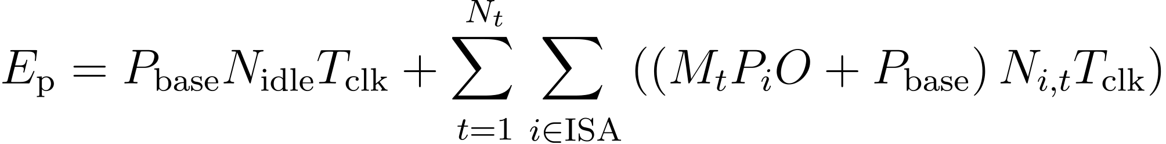
XCore Energy Modelling
Energy Cost (E) of a multi-threaded program (P):
Idle base power and duration
Concurrency cost, instruction cost, generalised overhead, base power and duration
Use of execution statistics rather than execution trace.
Fast running model with an average error margin of less than 7%
S. Kerrison and K. Eder. 2015. “Energy Modeling of Software for a Hardware Multithreaded Embedded Microprocessor”. ACM Trans. Embed. Comput. Syst. 14, 3, Article 56 (April 2015), 25 pages. DOI=10.1145/2700104 http://doi.acm.org/10.1145/2700104

Slide 95
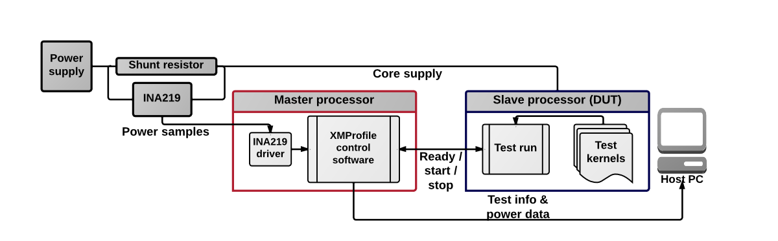
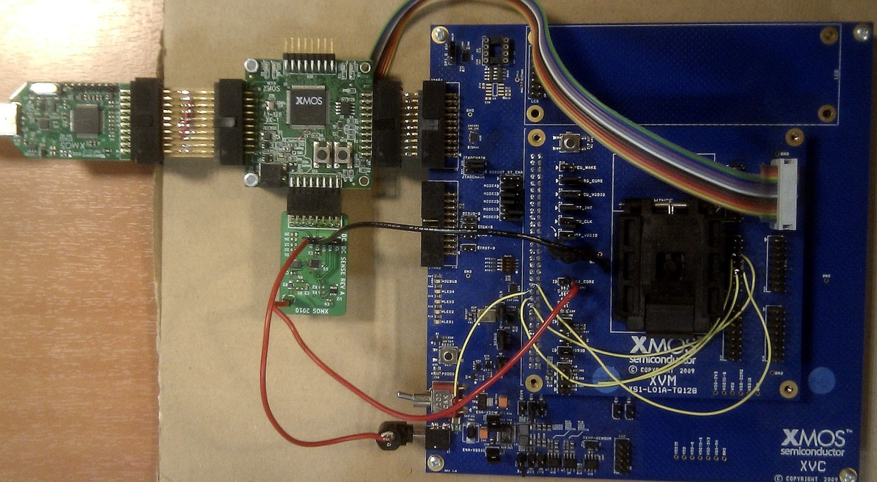
The set up...
S. Kerrison and K. Eder. 2015. “Energy Modeling of Software for a Hardware Multithreaded Embedded Microprocessor”. ACM Trans. Embed. Comput. Syst. 14, 3, Article 56 (April 2015), 25 pages. DOI=10.1145/2700104 http://doi.acm.org/10.1145/2700104

Slide 96
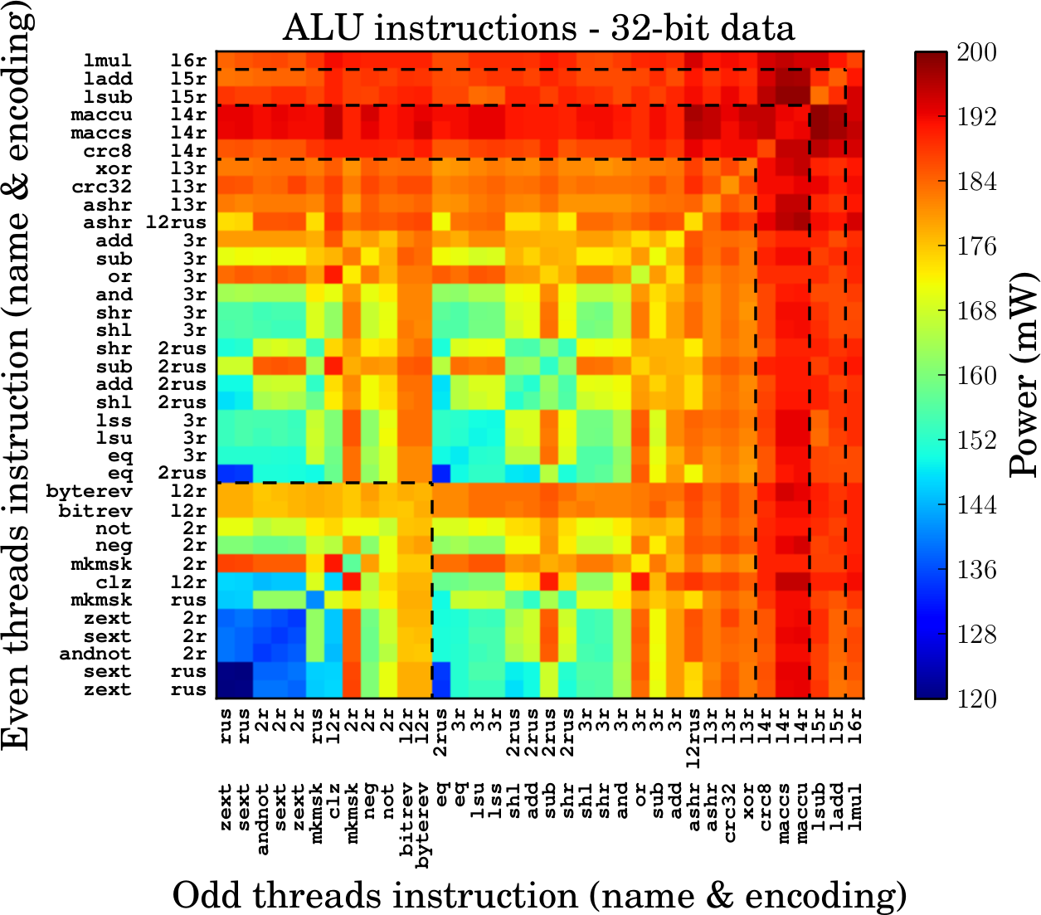
ISA Characterization

Slide 97
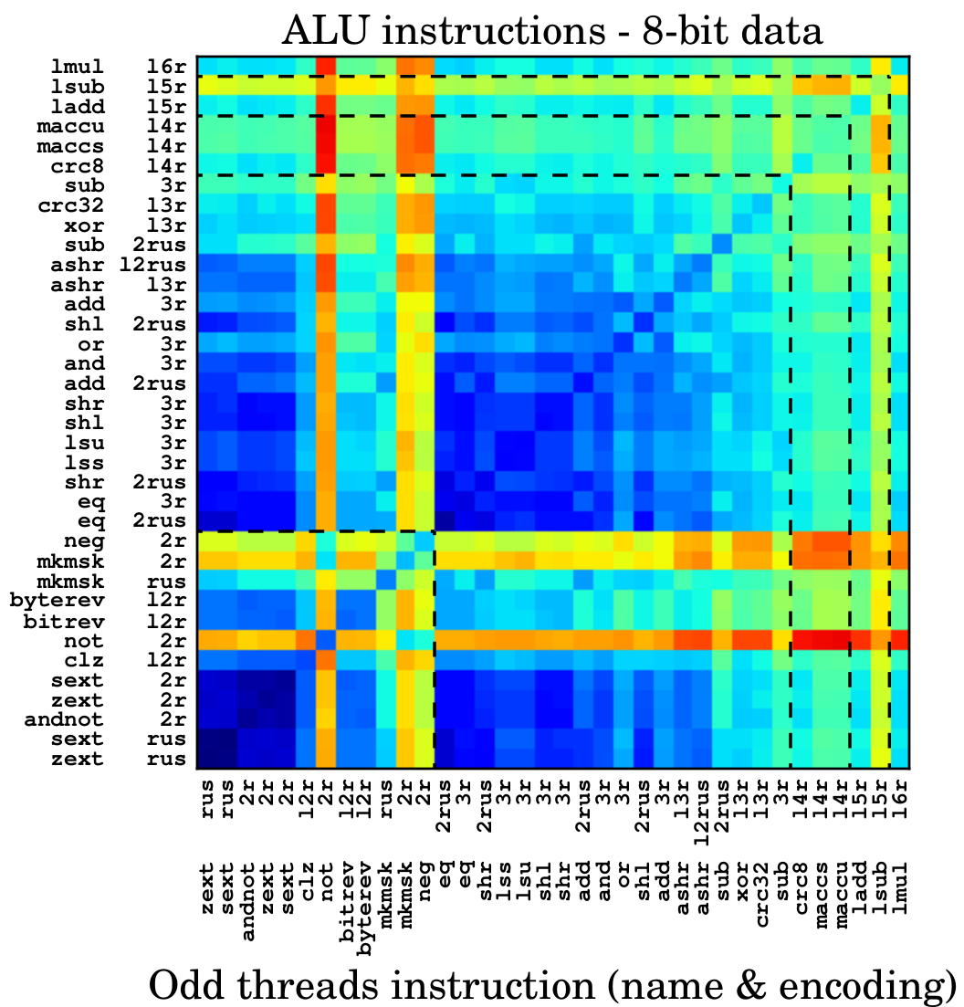
ISA Characterization
S. Kerrison and K. Eder. 2015. “Energy Modeling of Software for a Hardware Multithreaded Embedded Microprocessor”. ACM Trans. Embed. Comput. Syst. 14, 3, Article 56 (April 2015), 25 pages. DOI=10.1145/2700104 http://doi.acm.org/10.1145/2700104

Slide 98
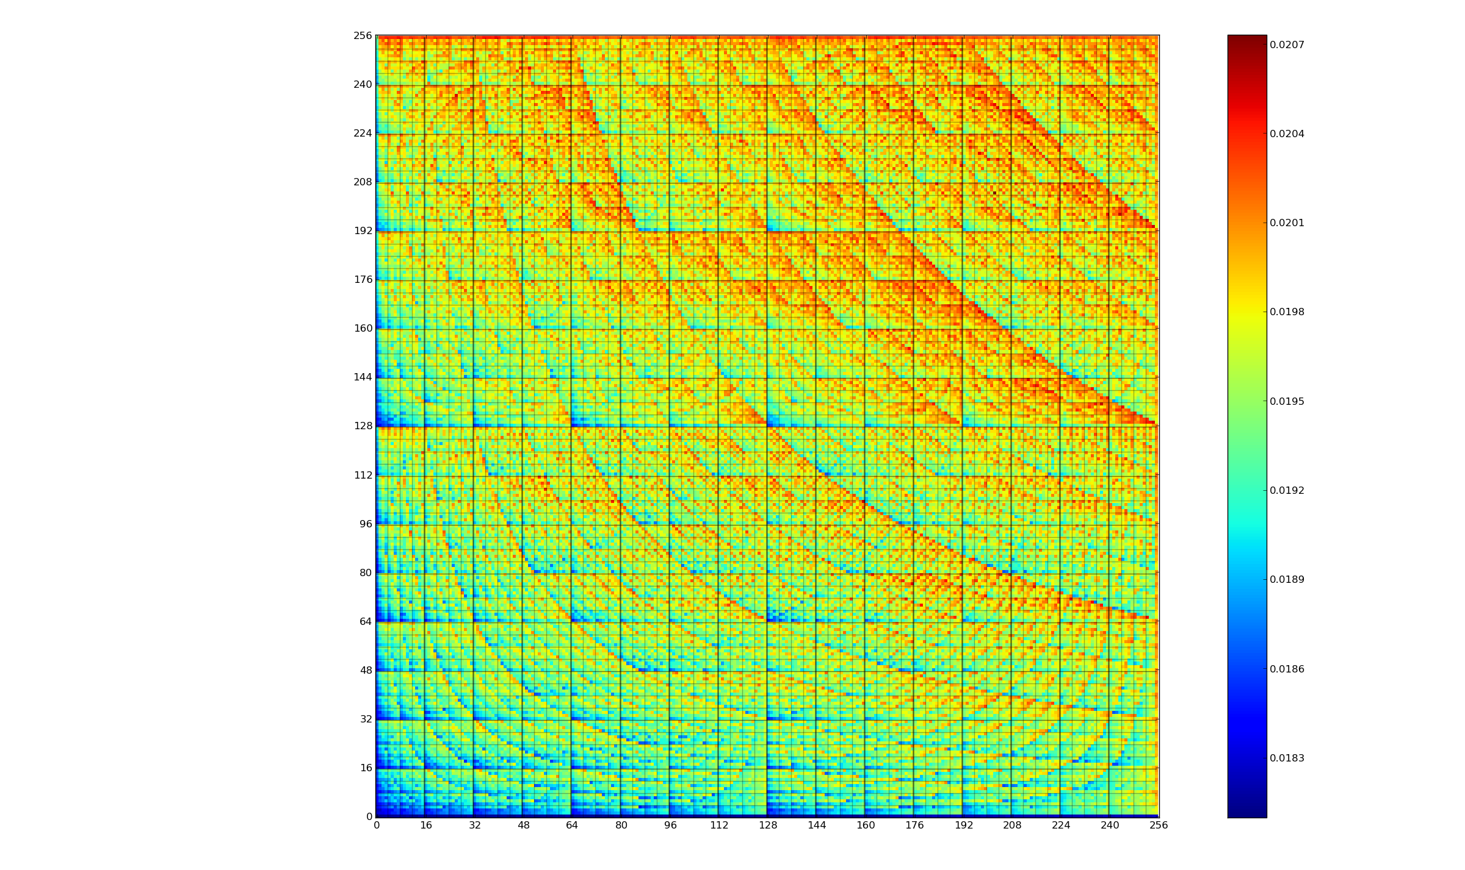
a*b = b*a
Notes:
We all know that a*b=b*a, but did you know that E(a*b != E(b*a)
I've attached the mul graph.
Details about the AVR mul:
16 bit result, (implicitly) stored in r1:r0
mul X, Y (x-axis of the graph is the first operand)
Colour bar units: joules

Slide 99
Energy(a*b) ≠ Energy(b*a)

Slide 100
ISA Characterization

Slide 101
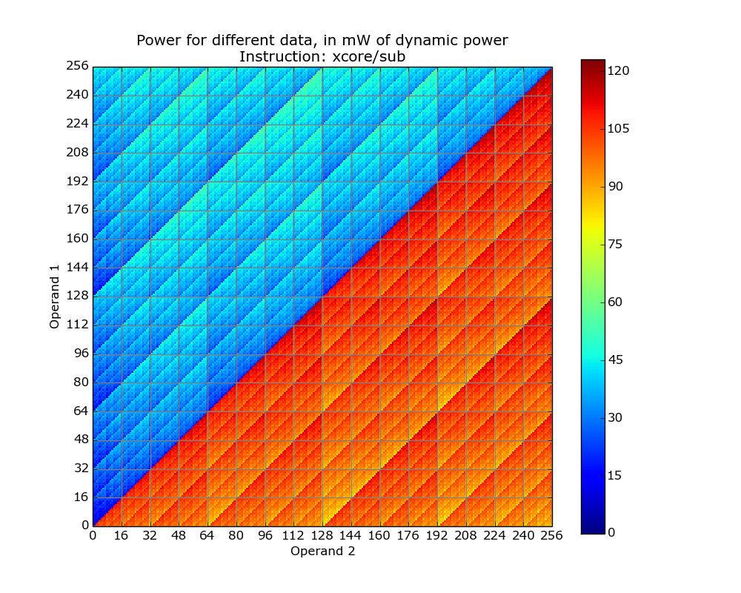
W/A/B-Case Energy Consumption

Slide 102
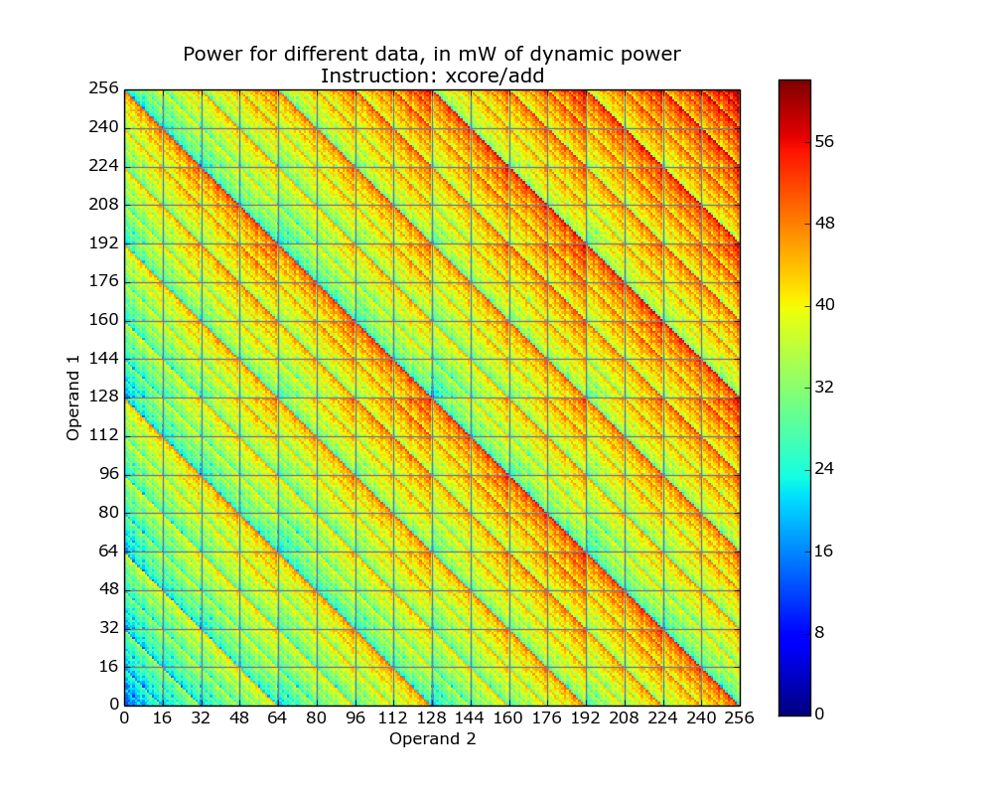
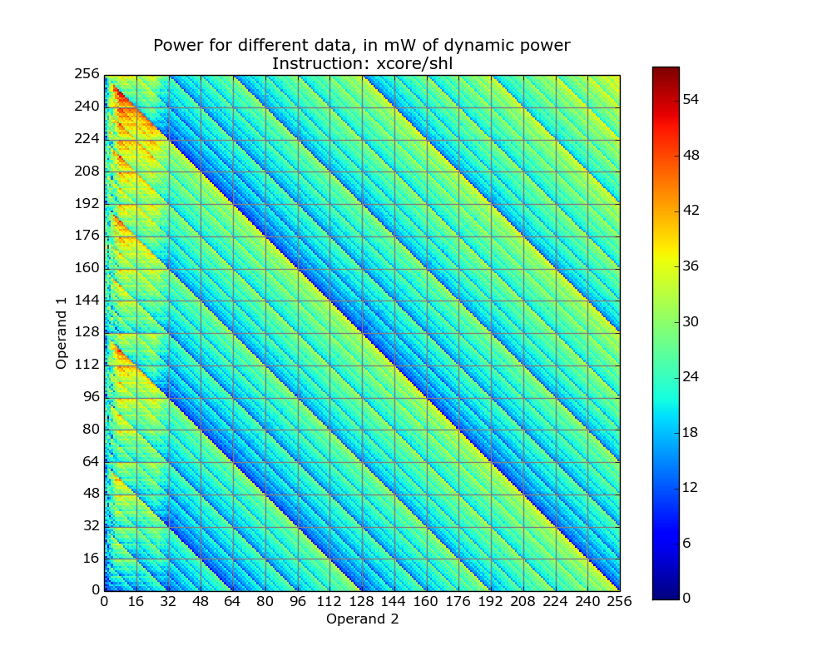
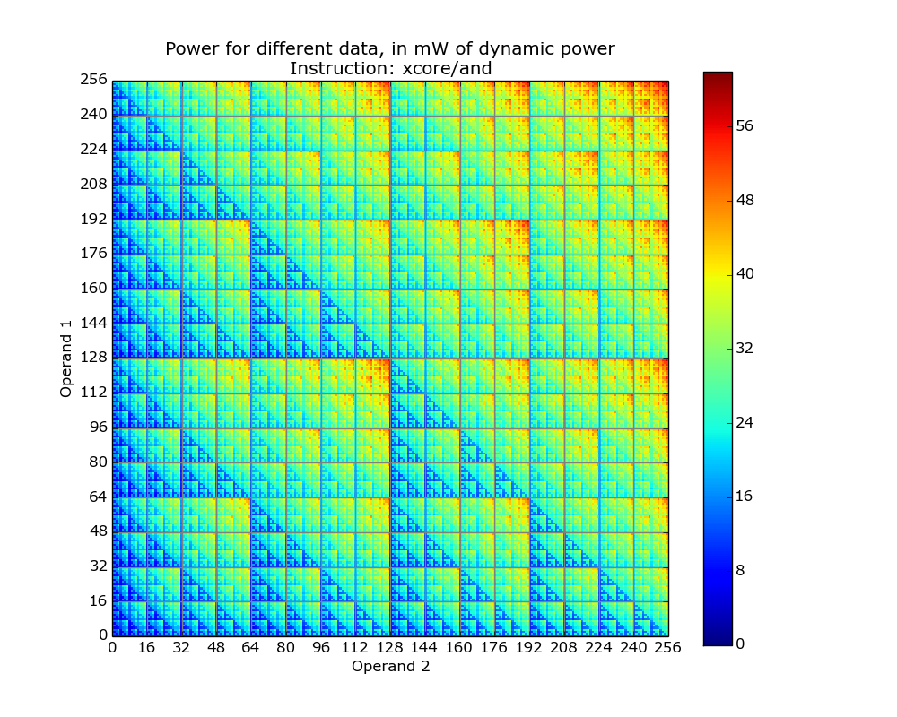
W/A/B-Case Energy Consumption
Notes:
These show the overhead caused by different data, i.e. on top of the instruction base cost.
Note, the colour scale is not the same for each!!!

Slide 103
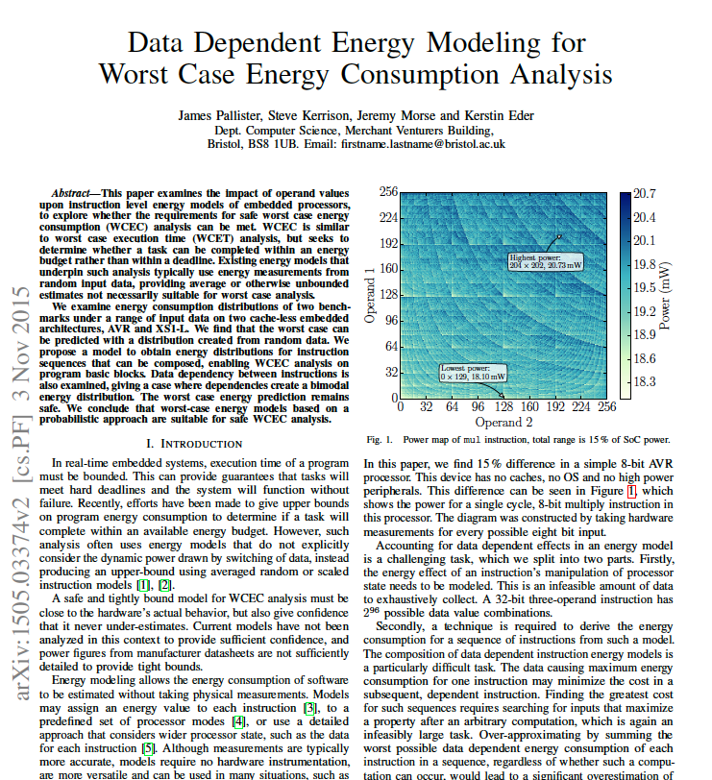

Slide 104


Slide 105
Impact of datapath switching
J. Morse, S. Kerrison and K. Eder. 2016. “On the infeasibility of analysing worst case dynamic energy”. (under review) http://arxiv.org/abs/1603.02580
Notes:
- Dynamic Power of add instruction in mW
Hamming weight of output datapath in number of bits set
Dynamic power in mW for add instruction, with output datapath cost subtracted (assuming 4.4mW per bit)
Hamming weight of both input operands to an add instruction, in number of bits set
Dynamic power in mW with input datapath cost subtracted (assuming 1.3mW per bit)
Dynamic power in mW with output and input datapath costs subtracted

Slide 106
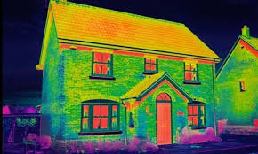
Energy Consumption Analysis enables energy transparency
www.theguardian.com

Slide 107

Energy Consumption Analysis enables energy transparency
www.theguardian.com
http://us.123rf.com/450wm/kentoh/kentoh1006/kentoh100600301/7129999-futuristic-technology-data-flow-as-art-background.jpg

Slide 108
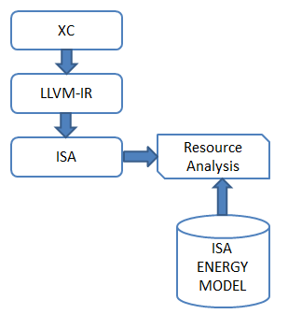
SRA at the ISA Level
Combine static resource analysis (SRA) with the ISA-level energy model.
Provide energy consumption function parameterised by some property of the program or its data.

Slide 109
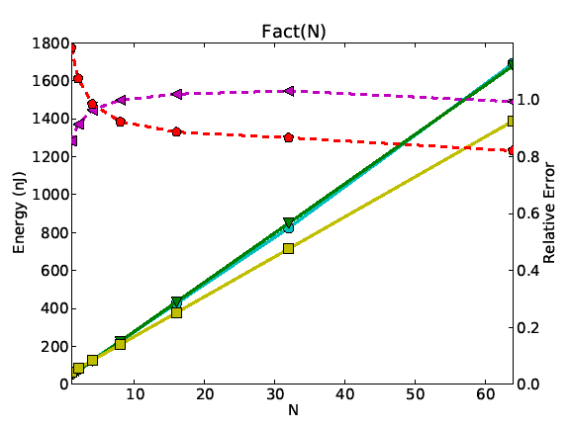
Static Energy Usage Analysis
Original Program:
Extracted Cost Relations:
int fact (int x) {
if (x<=0)ª
return 1^{b};
return (x *^{d} fact(x-1))^{c};
}
C_{fact}(x) = C_{a} + C_{b} if x<=0
C_{fact}(x) = C_{a} + C_{c}(x) if x>0
C_{c}(x) = C_{d} + C_{fact}(x-1)
Substitute C_{a}, C_{b}, C_{d} with
the actual energy required to execute the corresponding lower-level (machine) instructions.
Solve equation using off-the-shelf solvers.
Result: C_{fact}(x) = (26x + 19.4) nJ
109

Slide 110
ISA-Level Analysis Results
U. Liqat, S. Kerrison, A. Serrano, K. Georgiou, N. Grech, P. Lopez-Garcia, M.V. Hermenegildo and K. Eder. “Energy Consumption Analysis of Programs based on XMOS ISA-Level Models”. LOPSTR 2013.

Slide 111
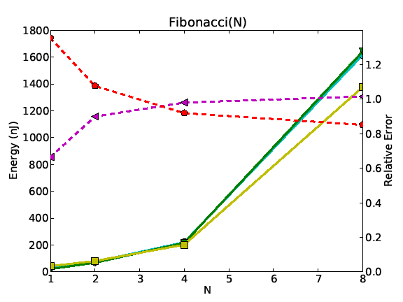
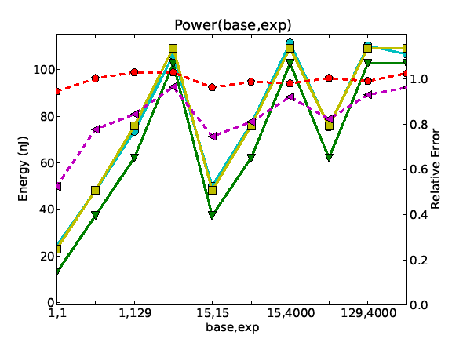
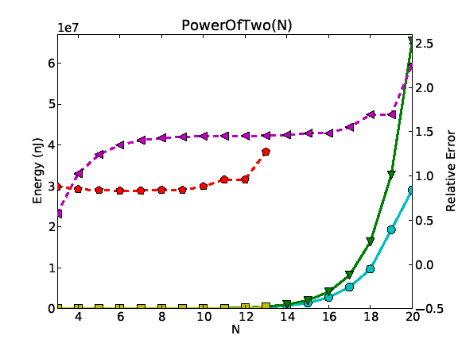
ISA-Level Analysis Results
U. Liqat, S. Kerrison, A. Serrano, K. Georgiou, N. Grech, P. Lopez-Garcia, M.V. Hermenegildo and K. Eder. “Energy Consumption Analysis of Programs based on XMOS ISA-Level Models”. LOPSTR 2013.

Slide 112
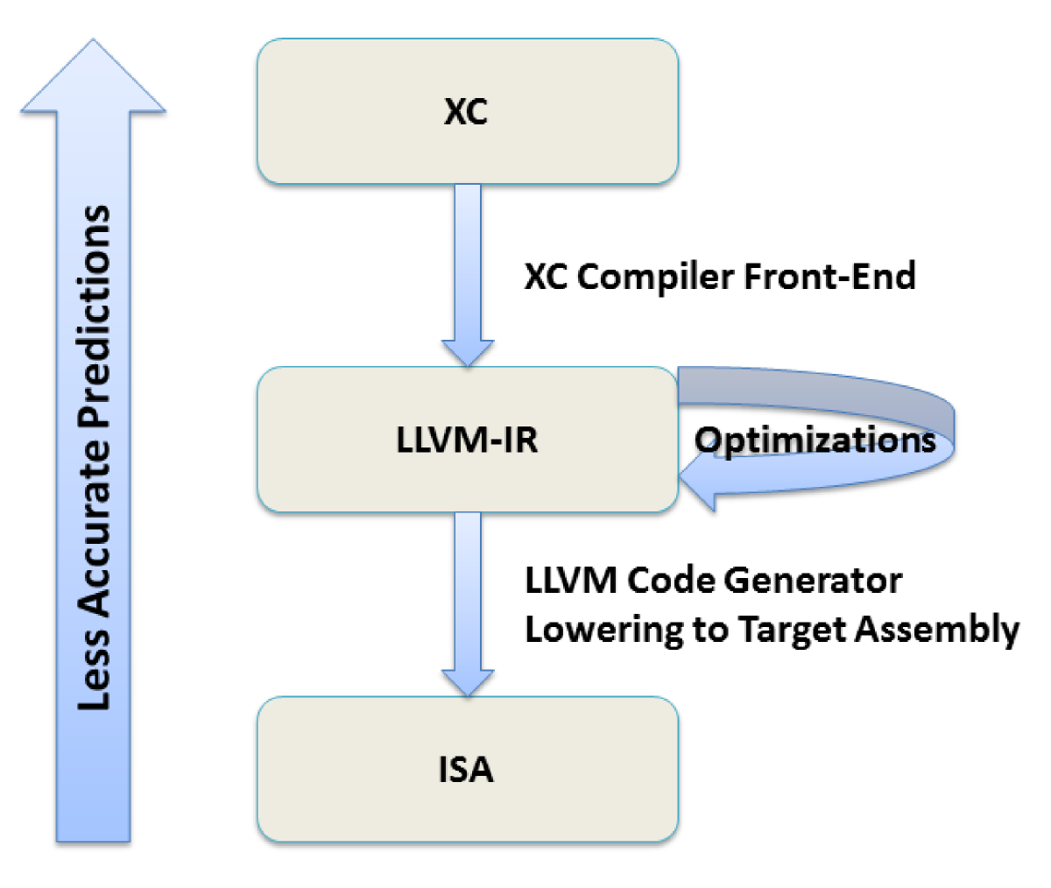
Analysis Options
Moving away from the underlying model risks loss of accuracy.
But it brings us closer to the original source code.
112
Notes:
A larger class of programs can be analyzed at LLVM IR level than at ISA level, because the LLVM IR level retains a lot of information on code structure and typing, which is lost at the ISA level.

Slide 113


Energy Consumption of LLVM IR
K. Georgiou, S. Kerrison and K. Eder, Oct 2015. “On the Value and Limits of Multi-level Energy Consumption Static Analysis for Deeply Embedded Single and Multi-threaded Programs”. http://arxiv.org/abs/1510.07095
U. Liqat, K. Georgiou, S. Kerrison, P. Lopez-Garcia, J.P. Gallagher, M.V. Hermenegildo, K. Eder. Inferring Parametric Energy Consumption Functions at Different Software Levels: ISA vs. LLVM IR. In Proceedings of FOPARA 2015. http://arxiv.org/abs/1511.01413

Slide 114


Analysis at the LLVM-IR Level
N. Grech, K. Georgiou, J. Pallister, S. Kerrison, J. Morse, K. Eder. 2015. Static analysis of energy consumption for LLVM IR programs. In Proceedings of the 18th International Workshop on Software and Compilers for Embedded Systems (SCOPES '15). ACM, New York, NY, USA, pages 12-21. http://dx.doi.org/10.1145/2764967.2764974

Slide 115
EC Static Analysis Results
K. Georgiou, S. Kerrison and K. Eder, Oct 2015. “On the Value and Limits of Multi-level Energy Consumption Static Analysis for Deeply Embedded Single and Multi-threaded Programs”. http://arxiv.org/abs/1510.07095

Slide 116
EC Static Analysis Results
K. Georgiou, S. Kerrison and K. Eder, Oct 2015. “On the Value and Limits of Multi-level Energy Consumption Static Analysis for Deeply Embedded Single and Multi-threaded Programs”. http://arxiv.org/abs/1510.07095

Slide 117
EC Static Analysis Results
K. Georgiou, S. Kerrison and K. Eder, Oct 2015. “On the Value and Limits of Multi-level Energy Consumption Static Analysis for Deeply Embedded Single and Multi-threaded Programs”. http://arxiv.org/abs/1510.07095

Slide 118
Towards Energy Aware Software Engineering

Slide 119

Energy Transparency
For HW designers:
“Power is a 1st and last order design constraint.”
[Dan Hutcheson, VLSI Research, Inc., E³S Keynote 2011]
“Every design is a point in a 2D plane.”
[Mark Horowitz,E³S 2009]
119

Slide 120

Energy Transparency
For HW designers:
“Power is a 1st and last order design constraint.”
[Dan Hutcheson, VLSI Research, Inc., E³S Keynote 2011]
“Every design is a point in a 2D plane.”
[Mark Horowitz,E³S 2009]
120

Slide 121

Energy Transparency
For HW designers:
“Power is a 1st and last order design constraint.”
[Dan Hutcheson, VLSI Research, Inc., E³S Keynote 2011]
“Every design is a point in a 2D plane.”
[Mark Horowitz,E³S 2009]
121

Slide 122

Energy Transparency
For HW designers:
“Power is a 1st and last order design constraint.”
[Dan Hutcheson, VLSI Research, Inc., E³S Keynote 2011]
“Every design is a point in a 2D plane.”
[Mark Horowitz,E³S 2009]
122

Slide 123
More POWER to SW Developers
Full Energy Transparency
from HW to SW
Location-centric programming model
in 5pJ do {...}
“Cool” code for green software
A cool programming competition!
Promoting energy efficiency
to a 1st class SW design goal is an
urgent research challenge.
Pictures taken from the Energy Efficient Computing Brochure at: https://connect.innovateuk.org/documents/3158891/9517074/Energy%20Efficient%20Computing%20Magazine?version=1.0
123
Notes:
For decades, moved SW dev away from HW – need to bridge the gap!
Location-centric programming to expose cost of communication to developers ☺

Slide 124











EACO @ Bristol
The Energy-Aware COmputing Initiative, Research Agenda and Workshops
http://www.cs.bris.ac.uk/Research/Micro/eaco.jsp

Slide 125


EACO Research at Bristol
EACO Platform
Online power monitoring
RTOS API
EACOF (github.com/eacof)
API for SW energy measurement
Machine Guided Energy Efficient Compilation (MAGEEC)
Superoptimization for low energy
Whole Systems Energy Transparency (ENTRA)
Application
Algorithms
Program
Compiler
OS
ISA
Functional Blocks
RTL / micro-architecture
Synthesis
Gate
Layout

Slide 126

The ICT-Energy CSA
http://www.ict-energy.eu/
Notes:
link to video at www.ict-energy.eu
OR
ICT-Energy project.mp4 file locally

Slide 127



Slide 128


ICT-Energy Summer School
13-16 August 2016
Aalborg, DK
Topics:
Basic on the physics of energy transformations at micro and nanoscales
Introduction to energy harvesting and distributed autonomous mobile devices
Software and energy aware computing
High performance computing and systems
http://www.nipslab.org/summerschool2016

Slide 129


ICT Energy Summer School
13-16 August 2016, Aalborg
Notes:
… now getting ready for H2020 call in April
this time we are contributing towards setting the Strategic Research Agenda ;)
SRA in ICT-Energy CSA ☺

Slide 130

ICT-Energy Science Conference
1st International Conference on ICT-Energy
16-19 August 2016, Aalborg, DK
Session I: Fundamental limits in energy consumption of computing
Session II: Novel architectures and devices for energy efficient computing
Session III: Efficient Energy harvesting for autonomous devices
Session IV: Energy aware software
Session V: HPC energy constrains towards exascale computers
http://www.ict-energy.eu/scienceconference_home
Notes:
… now getting ready for H2020 call in April
this time we are contributing towards setting the Strategic Research Agenda ;)
SRA in ICT-Energy CSA ☺

Slide 131

ICT-Energy Strategic Research Roadmap
http://www.ict-energy.eu/sites/ict-energy.eu/files/ICTEnergySRA5.3.pdf
Notes:
… now getting ready for H2020 call in April
this time we are contributing towards setting the Strategic Research Agenda ;)
SRA in ICT-Energy CSA ☺

Slide 132










Thank you for your attention
Kerstin.Eder@bristol.ac.uk

Slide 134
If you want an ultimate low-power system, then you have to worry about energy usage at every level in the system design, and you have to get it right from top to bottom, because any level at which you get it wrong is going to lose you perhaps an order of magnitude in terms of power efficiency.
The hardware technology has a first-order impact on the power efficiency of the system, but you've also got to have software at the top that avoids waste wherever it can. You need to avoid, for instance, anything that resembles a polling loop because that's just burning power to do nothing.
I think one of the hard questions is whether you can pass the responsibility for the software efficiency right back to the programmer.
Do programmers really have any understanding of how much energy their algorithms consume?
I work in a computer science department, and it's not clear to me that we teach the students much about how long their algorithms take to execute, let alone how much energy they consume in the course of executing and how you go about optimizing an algorithm for its energy consumption.
Some of the responsibility for that will probably get pushed down into compilers, but I still think that fundamentally, at the top level, programmers will not be able to afford to be ignorant about the energy cost of the programs they write.
What you need in order to be able to work in this way at all is instrumentation that tells you that running this algorithm has this kind of energy cost and running that algorithm has that kind of energy cost.
You need tools that give you feedback and tell you how good your decisions are. Currently the tools don't give you that kind of feedback.
February 2010, acmqueue Interview with Steve Furber
The designer of the ARM chip shares lessons on energy-efficient computing at: http://queue.acm.org/detail.cfm?id=1716385
Steve Furber
134
Notes:
acmqueue> We've focused a lot on the hardware, and I think that's a very important
context in the framework of what's going on with energy and computing. Looking
forward, is most of this pursuit to be energy efficient going to be achieved by
advances in the component and hardware technology, or is it also going to have
great consequence for software developers?
134

Slide 135
If you want an ultimate low-power system, then you have to worry about energy usage at every level in the system design, and you have to get it right from top to bottom, because any level at which you get it wrong is going to lose you perhaps an order of magnitude in terms of power efficiency.
The hardware technology has a first-order impact on the power efficiency of the system, but you've also got to have software at the top that avoids waste wherever it can. You need to avoid, for instance, anything that resembles a polling loop because that's just burning power to do nothing.
I think one of the hard questions is whether you can pass the responsibility for the software efficiency right back to the programmer.
Do programmers really have any understanding of how much energy their algorithms consume?
I work in a computer science department, and it's not clear to me that we teach the students much about how long their algorithms take to execute, let alone how much energy they consume in the course of executing and how you go about optimizing an algorithm for its energy consumption.
Some of the responsibility for that will probably get pushed down into compilers, but I still think that fundamentally, at the top level, programmers will not be able to afford to be ignorant about the energy cost of the programs they write.
What you need in order to be able to work in this way at all is instrumentation that tells you that running this algorithm has this kind of energy cost and running that algorithm has that kind of energy cost.
You need tools that give you feedback and tell you how good your decisions are. Currently the tools don't give you that kind of feedback.
February 2010, acmqueue Interview with Steve Furber
The designer of the ARM chip shares lessons on energy-efficient computing at: http://queue.acm.org/detail.cfm?id=1716385
Steve Furber
135
Notes:
acmqueue> We've focused a lot on the hardware, and I think that's a very important
context in the framework of what's going on with energy and computing. Looking
forward, is most of this pursuit to be energy efficient going to be achieved by
advances in the component and hardware technology, or is it also going to have
great consequence for software developers?
135

